Slide 1
Year 12 Parents’ Information Evening 2026

Slide 2
What did they do to achieve these results…..?
….and…
…. what advice would they give you?

Slide 3
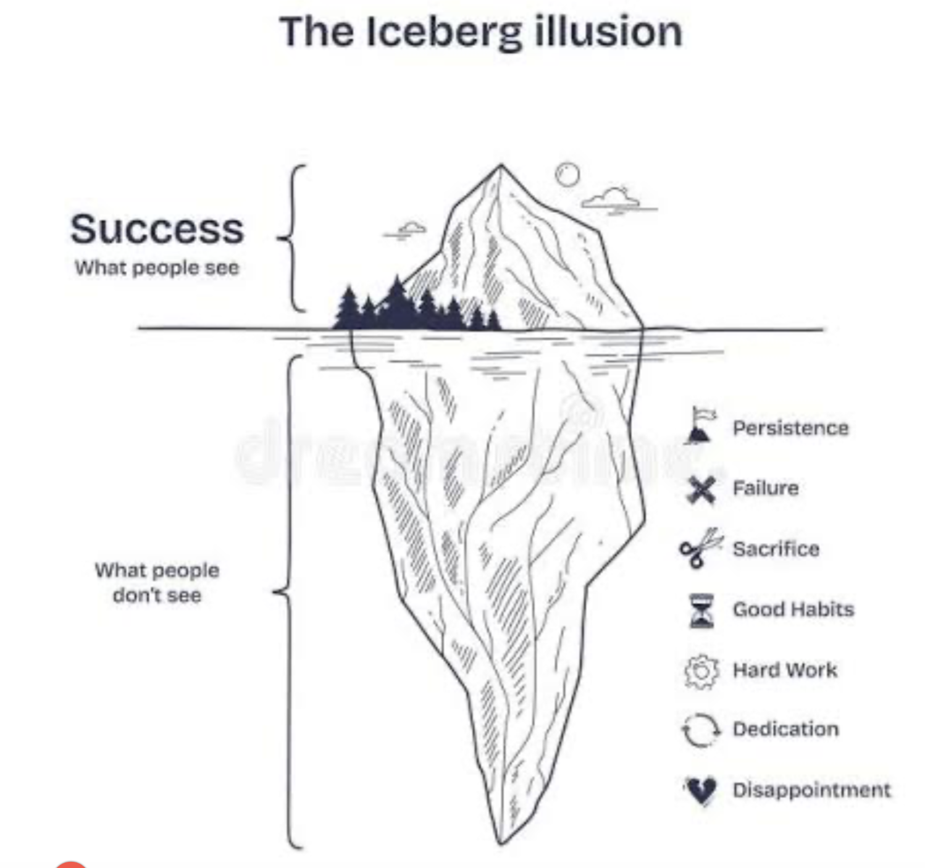

Slide 4
11 Things A level and Ctec students they wish they had done from the start…
Get organised (lever-arch files, dividers, poly pockets)
Use past papers, answer schemes and examiners reports
Make lots of notes (and re-read them in between lessons). Start revising early
Be prepared to work at home. Look ahead at what is to come and teach yourself.
Treat it like a job (phone to advise of an absence) but try to get in.
6. Respect your deadlines –
do your hwk. as soon as you get it
7. Make sure you understand each topic – aim to teach it to someone else or seek help
8. Don’t panic! Everyone finds it hard at first.
9. Don’t forget to have some fun. Take time off and make new friends
10. Don’t waste your free periods
11. Get some sleep

Slide 5
BALANCE BETWEEN ACADEMIC WORK, LEISURE AND PART-TIME WORK
Very important to get this right
You will enjoy leisure more if you have faced up to your academic commitments
Too much part-time work affects academic performance: More than 9-10 hours a week is probably too much

Slide 6

Advantages
Money!!
Meet new friends
New experiences
New responsibilities (Importance of reliability/punctuality)
Learn new skills & offers numerous teamwork opps.
Broader outlook on life outside school
Insight into business or industry (valuable work experience)

Slide 7

Disadvantages
Time taken from school work making it difficult to meet deadlines.
Lose focus on what is your REAL work
Get overtired and lose concentration in school
Not enough leisure time

Slide 8
THERE IS DEFINITELY A COST
Research at the University of Durham has compared A level & Level 3 students who do part-time work with those that do not.
0-9 hours part-time work a week, students on average half a grade down
More than 9 hours, one grade down
When matters: 2 hours after school is sensible. Long stretches in the evening or before school affect academic performance

Slide 9
STRIKE A BALANCE
Organise your life in a balanced way with time for academic work, time to relax and a sensible amount of part-time work to boost your income
Draw back from part-time work, work fewer hours, at academic pressure points especially around the Summer exams
Above all, be clear what your own priorities are in order to achieve your personal goals. You cannot do it all

Slide 10



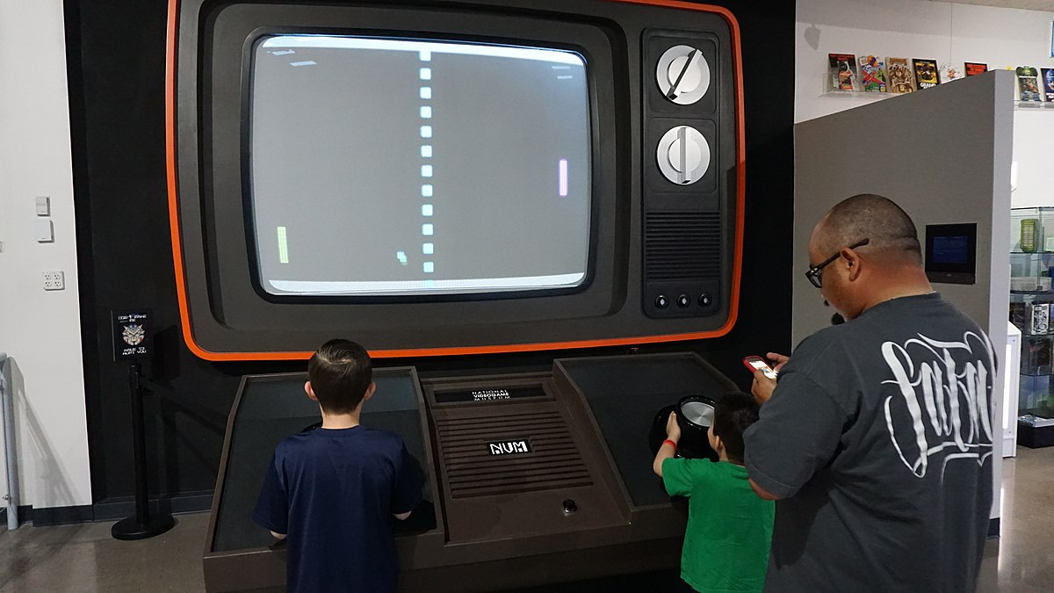
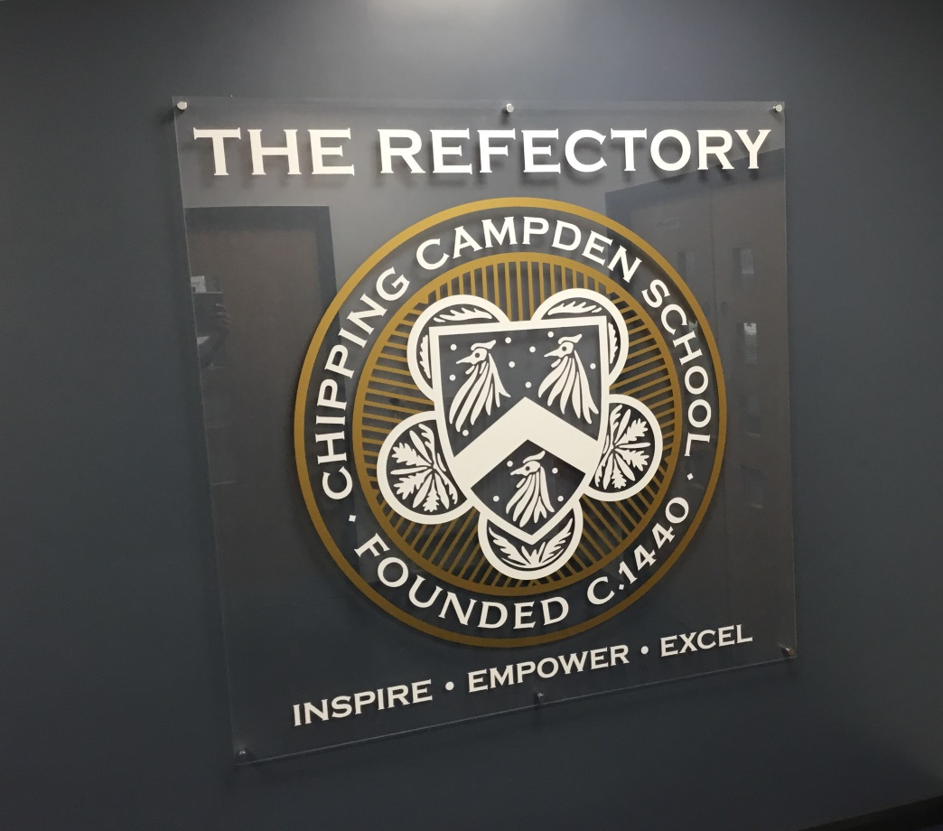
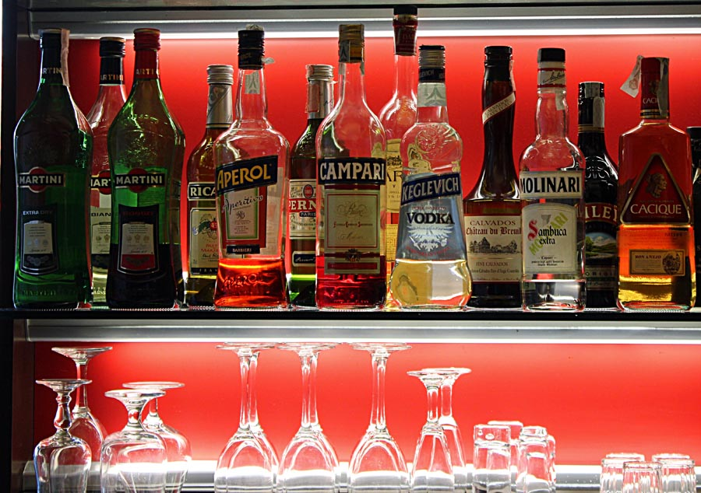
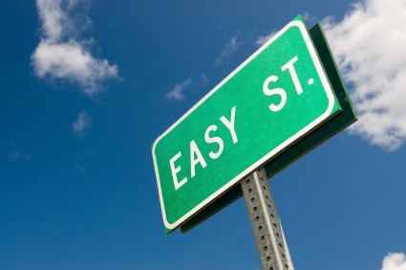

Distractions that will affect your grades

Slide 11
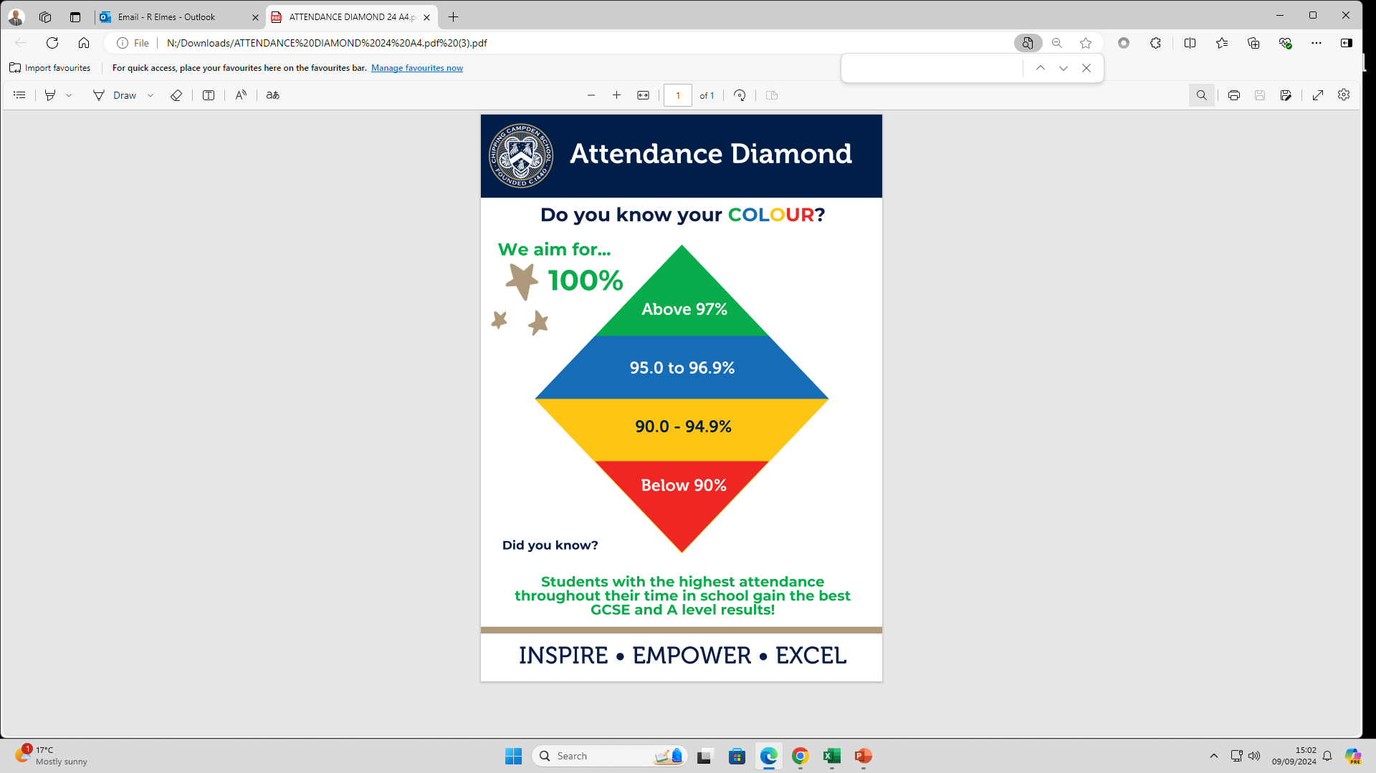

Slide 12
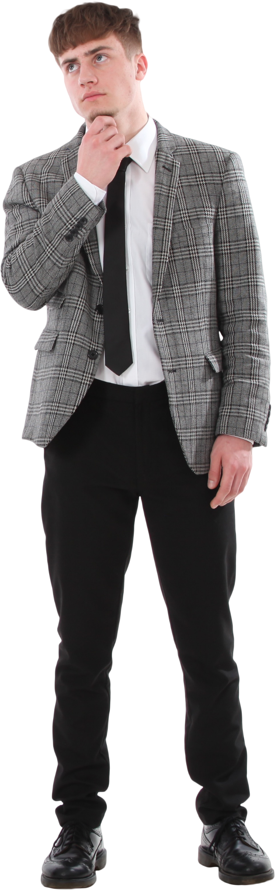
Why year 12 is so important
Half of the A level course out of the way before year 13
Good year 13 Entrance exam grades enhance UCAS applications and estimated grades
Good Year 13 Entrance exam grades enhance apprenticeship applications
Cannot progress into Year 13 in some cases
Personal pride
Good habits to take into year 13 and HE

Slide 13
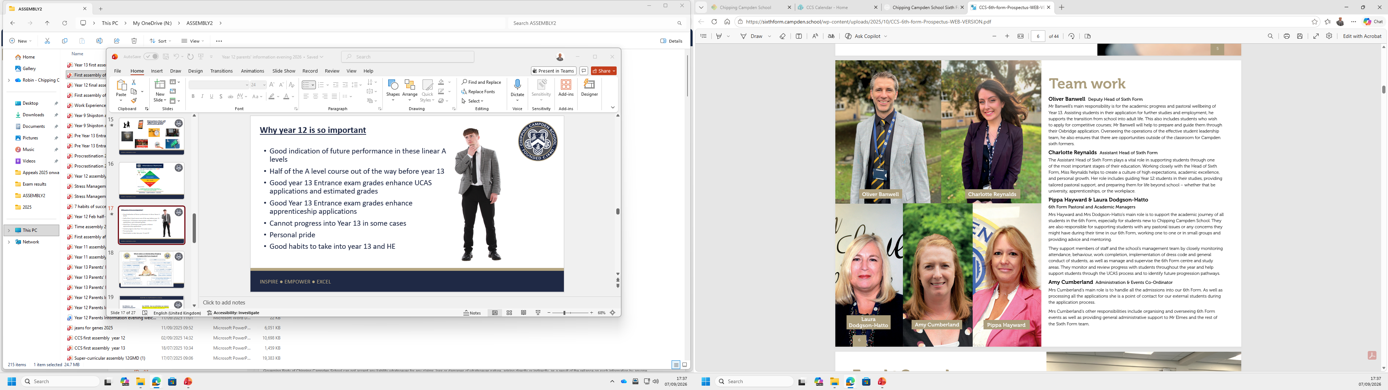
The Sixth Form Team 2026 - 2027

Slide 14
Year 12 & 13 Curriculum maps
A term by term outline of what your sons and daughters will be learning this year and next

Slide 15
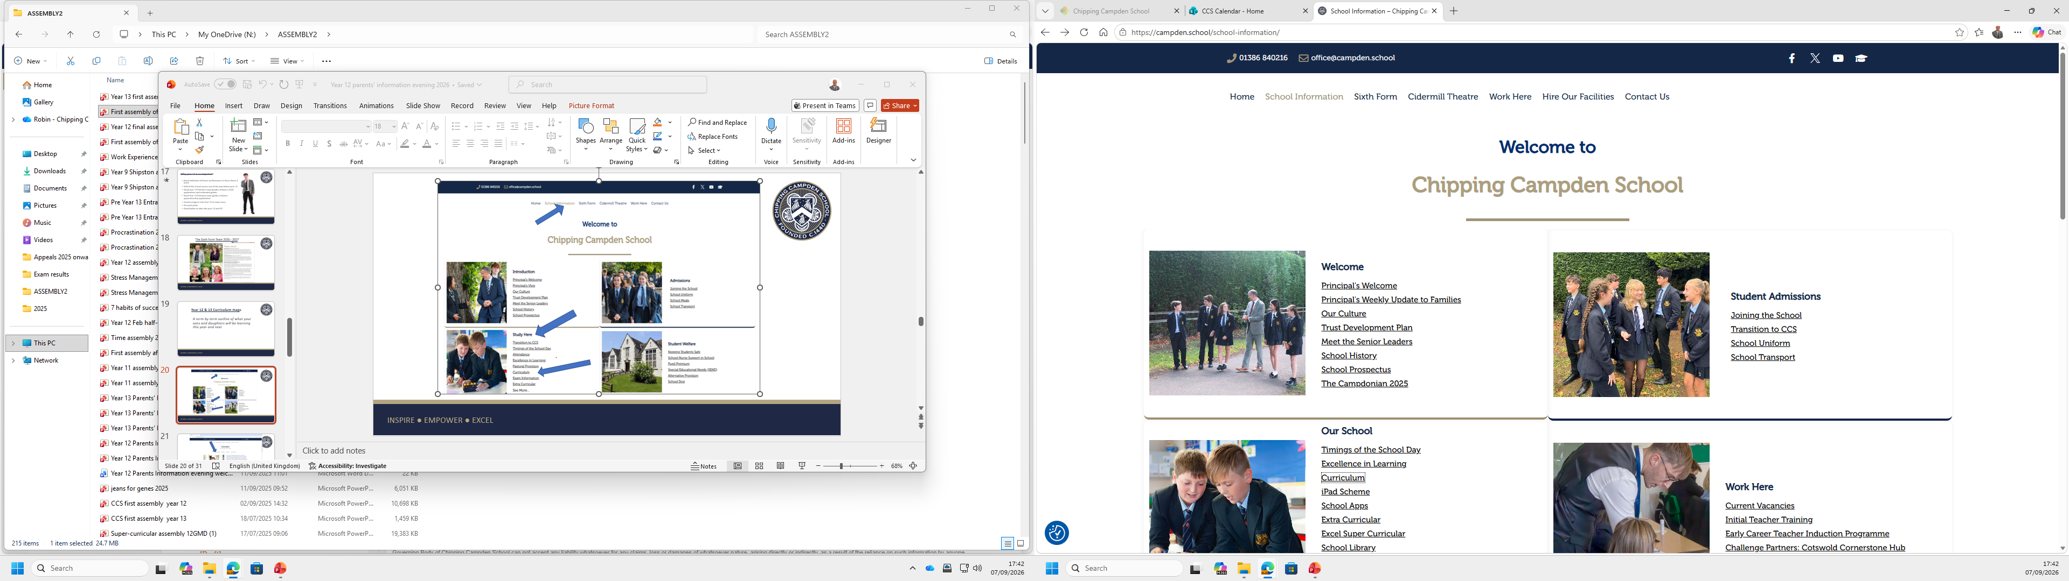

Slide 16
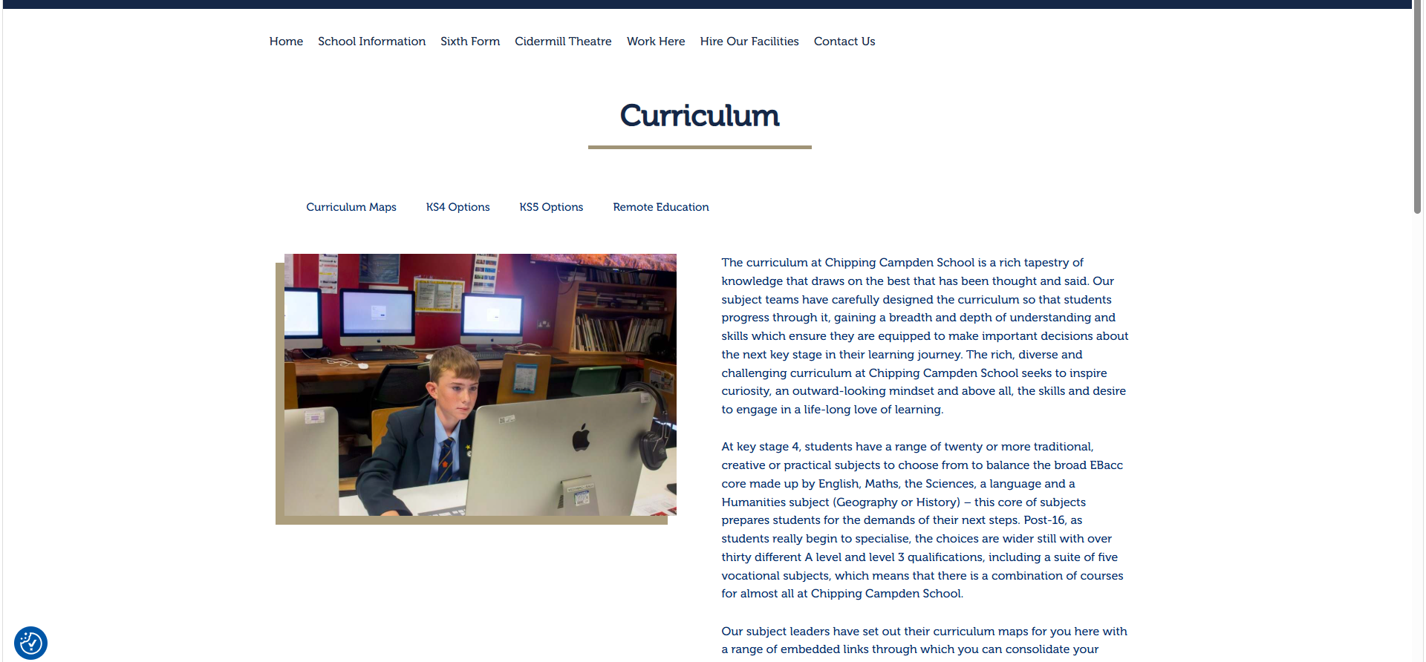

Slide 17
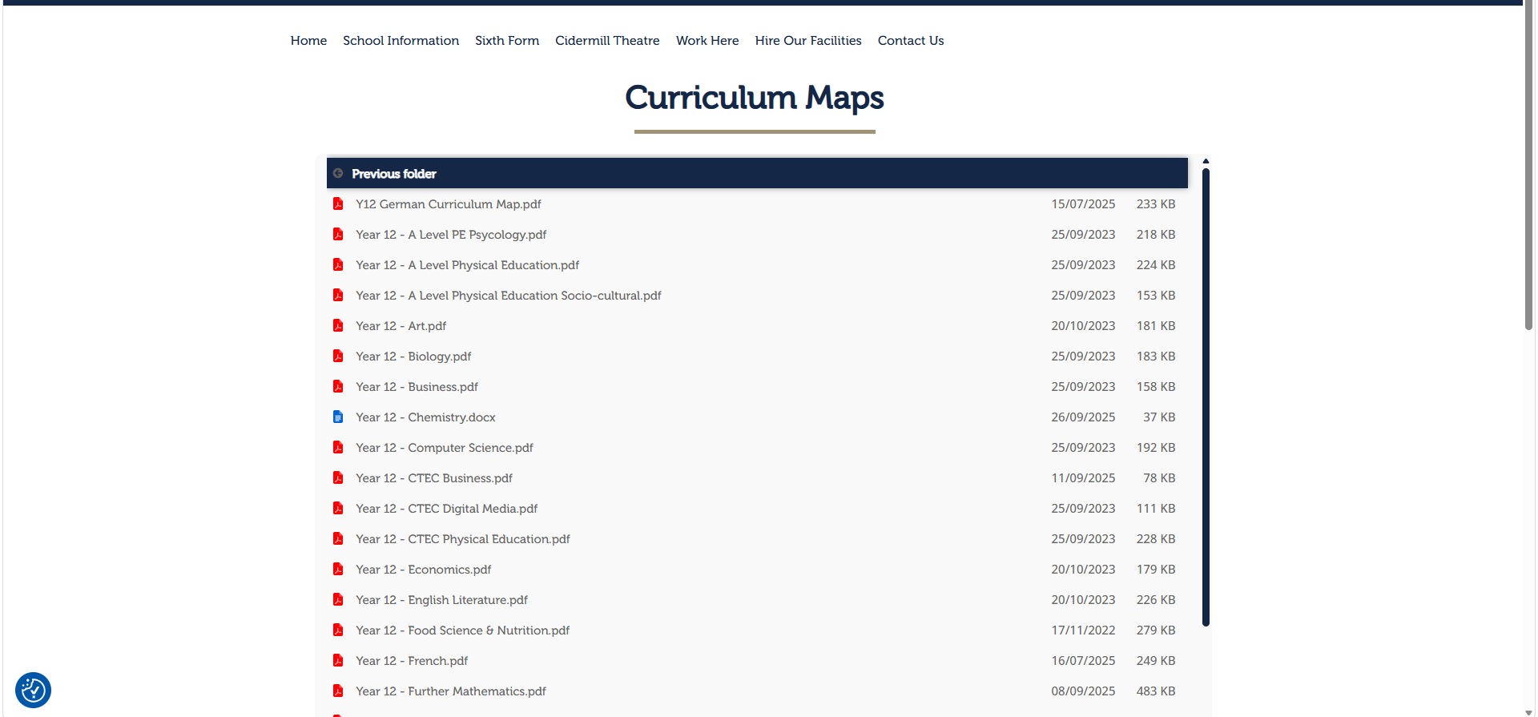

Slide 18
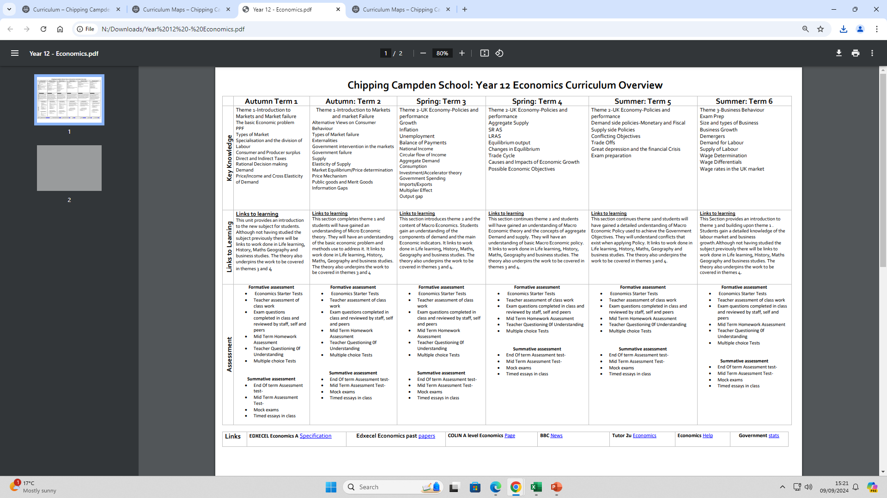

Slide 19
Year 12 monitoring, reports and parents’ evenings 2026-27
Ongoing with the Arbor points system and the Sixth Form Pen Award
Reporting schedule - you will receive regular data/attitude to learning reports on:
19th October 2026 (ATL + hwk.)
15th December 2026
16th March 2027
14th July 2027 (Entrance exam results)
Year 13 Entrance exams – 17th – 29th June 2027
2 x year 12 Parents’ evening – Thursday 1st October 2026 & 6th May 2027
Any other time that is convenient/necessary

Slide 20
Year 12 Work Experience week
Week commencing 5th July 2027

Slide 21
16-19 Bursary
Please remember that the School has a 16-19 bursary fund to enable some financial assistance to students whose access might be inhibited by financial barriers. The policy for the bursary is on the school website and the application form for consideration is attached. If you believe you are eligible for financial support and would like to make an application then please return the application form by the end of September and the decisions on the award will be communicated to you by the end of October.
All communications regarding financial support will be kept strictly confidential. Please send the applications to ldodgson-hatto@campden.school

Slide 22

KS5 Parents/open eveUNIGning
Subjects Library: Students can explore HE topics that interest them, and related jobs in the Explore section. They can increase their knowledge of a subject in the Geek Out section.
University & Apprenticeships: Students can explore opportunities available to them after they leave KS5
Personal Statement: Any students applying to UK Universities will write a personal statement.
CV Builder: All students (and parents!) can use the CV builder tool to apply for job opportunities.
Post-18 Intentions: The more information students can give about their intentions for after leaving KS5, the better they can be supported at school or college.

Slide 23

Super-Curricular
All students will have GCSE grades, A Level grades, some work experience. To truly stand out, employers and universities are interested in what else you have done.
Notes:
Excel badges through links on website. KS4 booklets for further extension as needed.

Slide 24
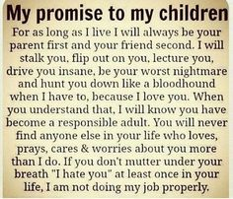
My reminder to students as to why you do what you do as parents………..

