Slide 1
Year 13 Parents’ Information Evening
R.Elmes
Vice Principal/Head of Sixth Form
O.Banwell
Deputy Head of Sixth Form
22nd September 2025

Slide 2


Slide 3
Post 16 Success – what is required?
Subject knowledge and skills
Determination
Organisiation
Most importantly….

Slide 4
“Others think I am clever. I am not clever, I just work hard”
Year 13 Student who recently achieved 3 A*s at A level

Slide 5
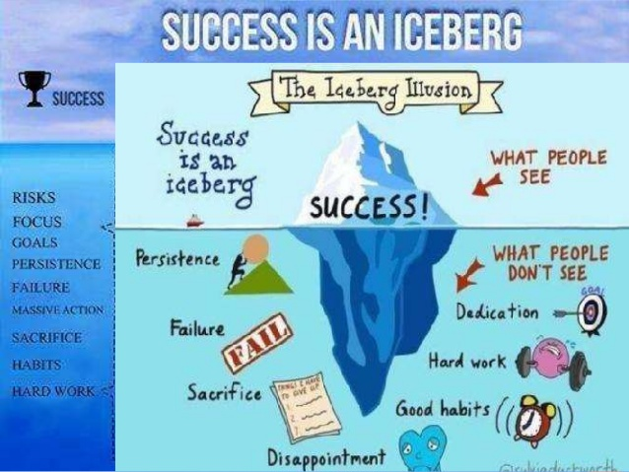

Slide 6
“There were many success stories in last year’s Year 13 who raised their game significantly in their 2nd year and went up many grades in one year”

Slide 7
Revision, exam preparation and coursework
Students should know how they learn best
‘Plan your work, work your plan’
Plan learning at home and in study periods
Quality and quantity

Slide 8
11 Things A level students wish they’d known
Use past papers, specimen papers, answer schemes and examiners’ reports
Make lots of notes (and re-read them in between lessons). Start revising early
Be prepared to work at home. Look ahead at what is to come and teach yourself.
Get organised (lever-arch files, dividers, poly pockets)
Treat it like a job (phone to advise of an absence) but try to get in.
6. Respect your deadlines –
do your hwk as soon as you get it
7. Make sure you understand each topic – aim to teach it to someone else or seek help
8. Don’t panic! Everyone finds post-16 education hard.
Don’t forget to have some fun. Take time off for recreation.
Don’t waste your free periods
11. Get some sleep

Slide 9
Distractions that will affect student grades….
…..if they let them!!!

Slide 10



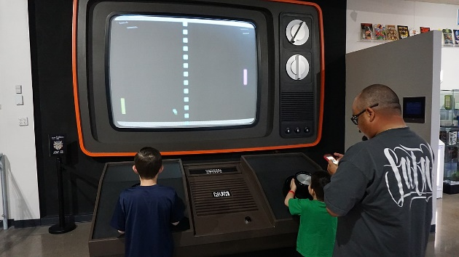


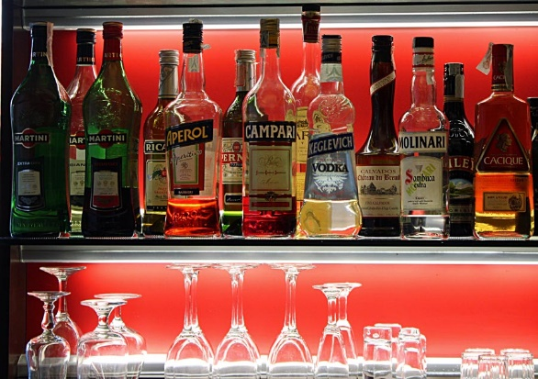


Slide 11
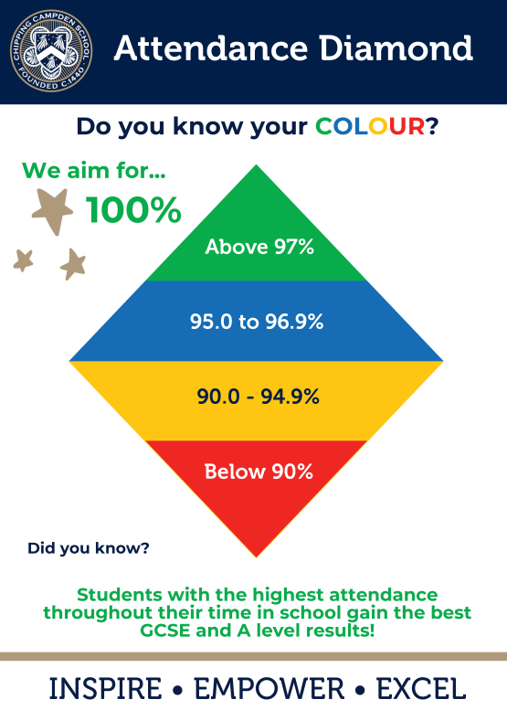

Slide 12
BALANCE BETWEEN ACADEMIC WORK, LEISURE AND PART-TIME WORK
Very important to get this right
You will enjoy leisure more if you have faced up to your academic commitments
Too much part-time work affects academic performance: More than 9-10 hours a week is probably too much

Slide 13
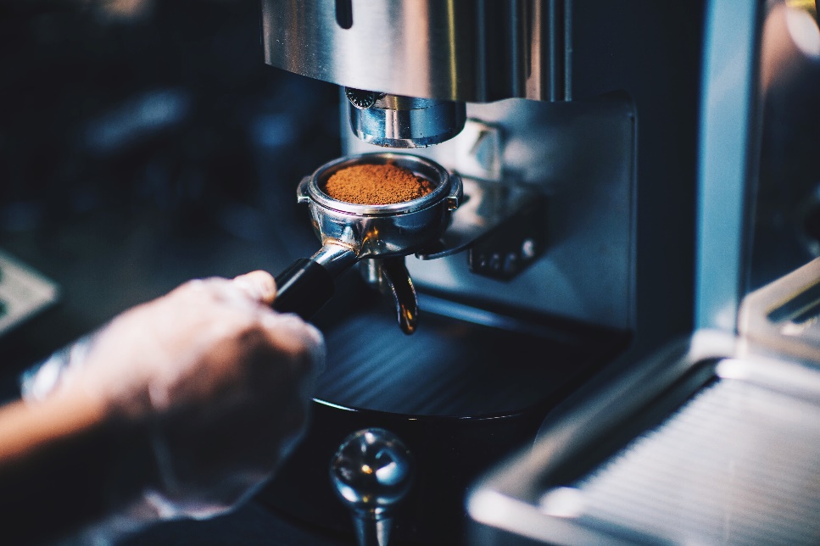
Part Time work - Advantages
Money!!
Meet new friends
New experiences
New responsibilities (Importance of reliability/punctuality)
Learn new skills (teamwork)
Broader outlook on life outside school
Insight into business or industry (valuable work experience)

Slide 14

Part Time work - Disadvantages
Time taken from school work making it difficult to meet deadlines.
Lose focus on what is your REAL work
Get overtired and lose concentration in school
Not enough leisure time

Slide 15
THERE IS DEFINITELY A COST
University of Durham research
0-9 hours part-time work a week, students on average half a grade down
More than 9 hours, one grade down
When matters: 2 hours after school is sensible.

Slide 16
STRIKE A BALANCE
Organise your life in a balanced way with time for academic work, time to relax and a sensible amount of part-time work to boost your income
Draw back from part-time work, work fewer hours, at academic pressure points especially around the Summer exams
Above all, be clear what your own priorities are in order to achieve your personal goals. You cannot do it all

Slide 17
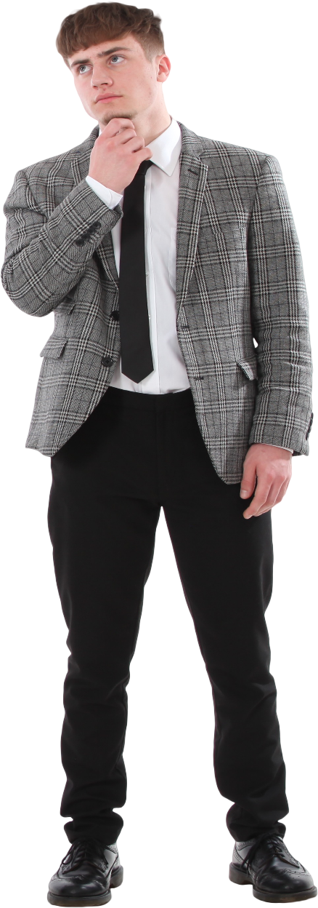
Why year 13 is so important
Crossroads in life…
…although there will be others
Personal pride
Good habits to take into HE, apprenticeship or career
Exams – May/June 2026

Slide 18
Ways to support your child's academic progress

Slide 19
Year 13 monitoring, reports and parents’ evenings 2025-26
Ongoing with the Arbor points system and the Sixth Form Pen Award
Reporting schedule - you will receive regular data/attitude to learning reports on:
14th October 2025 (ATL + hwk.)
4th December 2025 (Mock Assessment results)
17th March 2026 (Mock Exam results)
2 x year 13 Parents’ evening – Thursday 9th October 2025 & 22nd January 2026 (both online)
Any other time that is convenient/necessary

Slide 20
Year 12 & 13 Curriculum maps
A term by term outline of what your sons and daughters will be learning this year and next

Slide 21
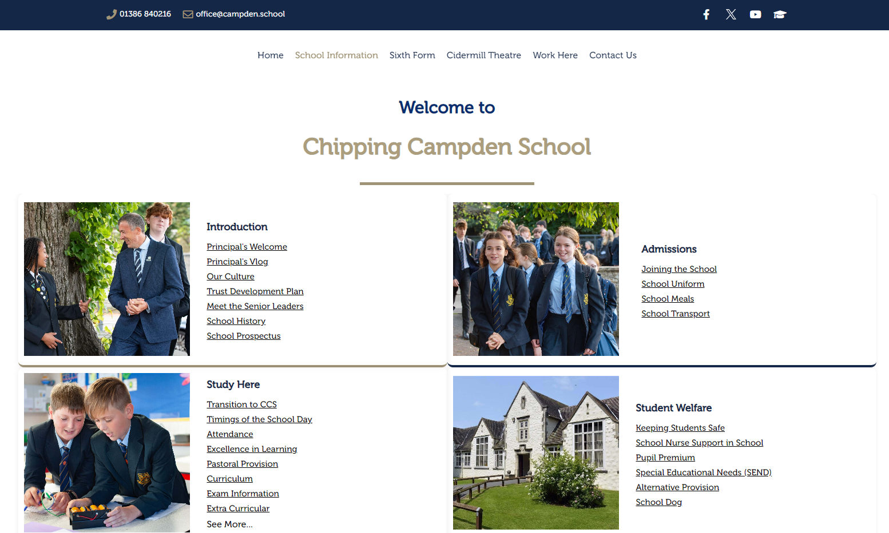

Slide 22
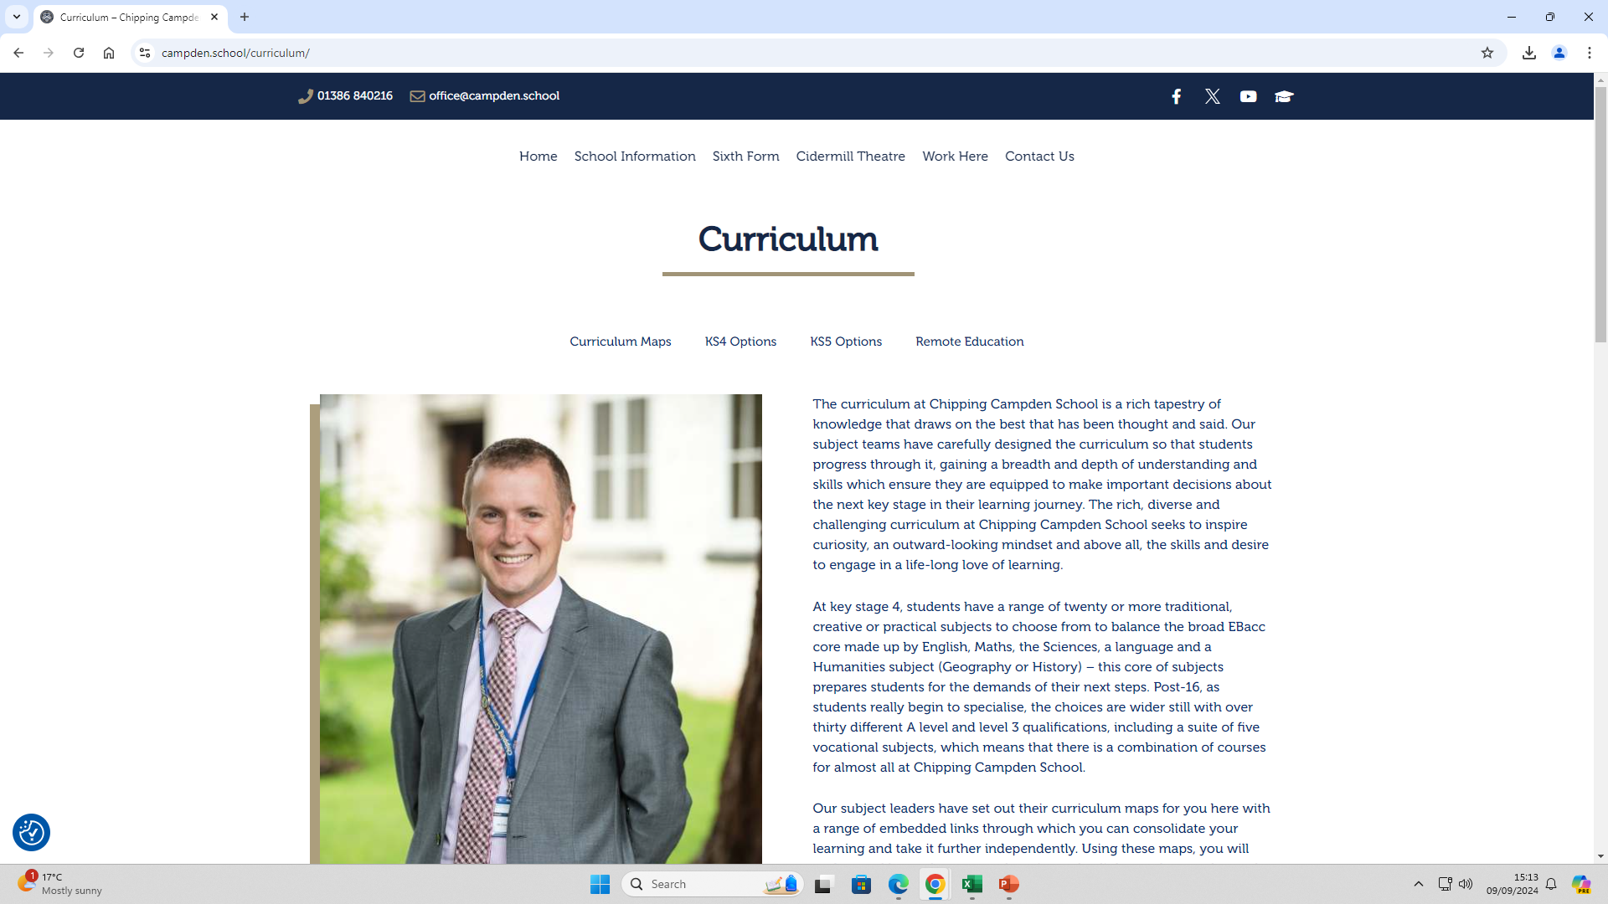

Slide 23
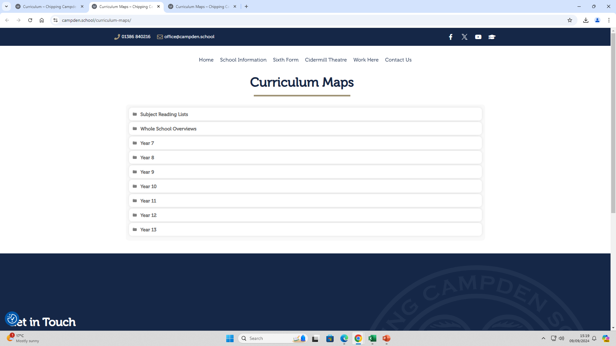

Slide 24
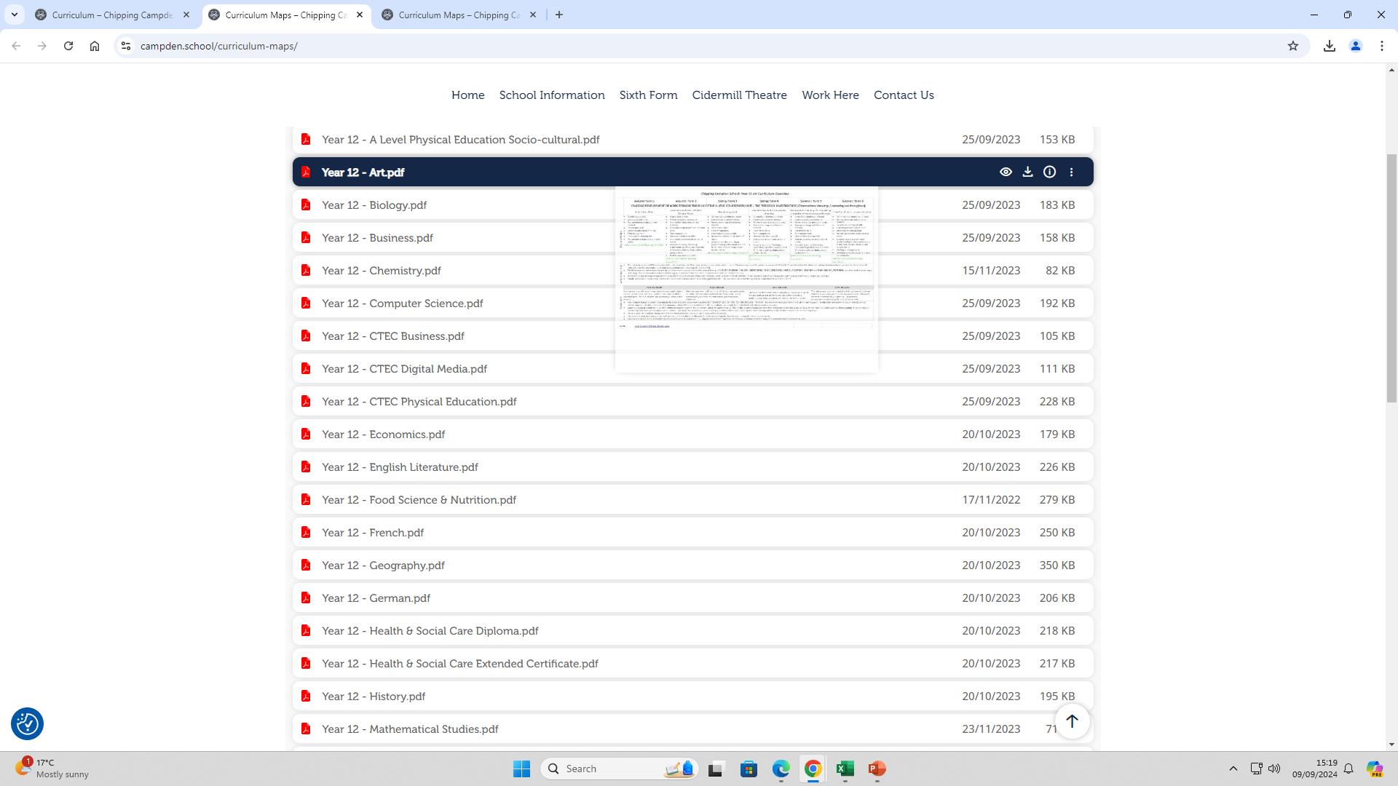

Slide 25
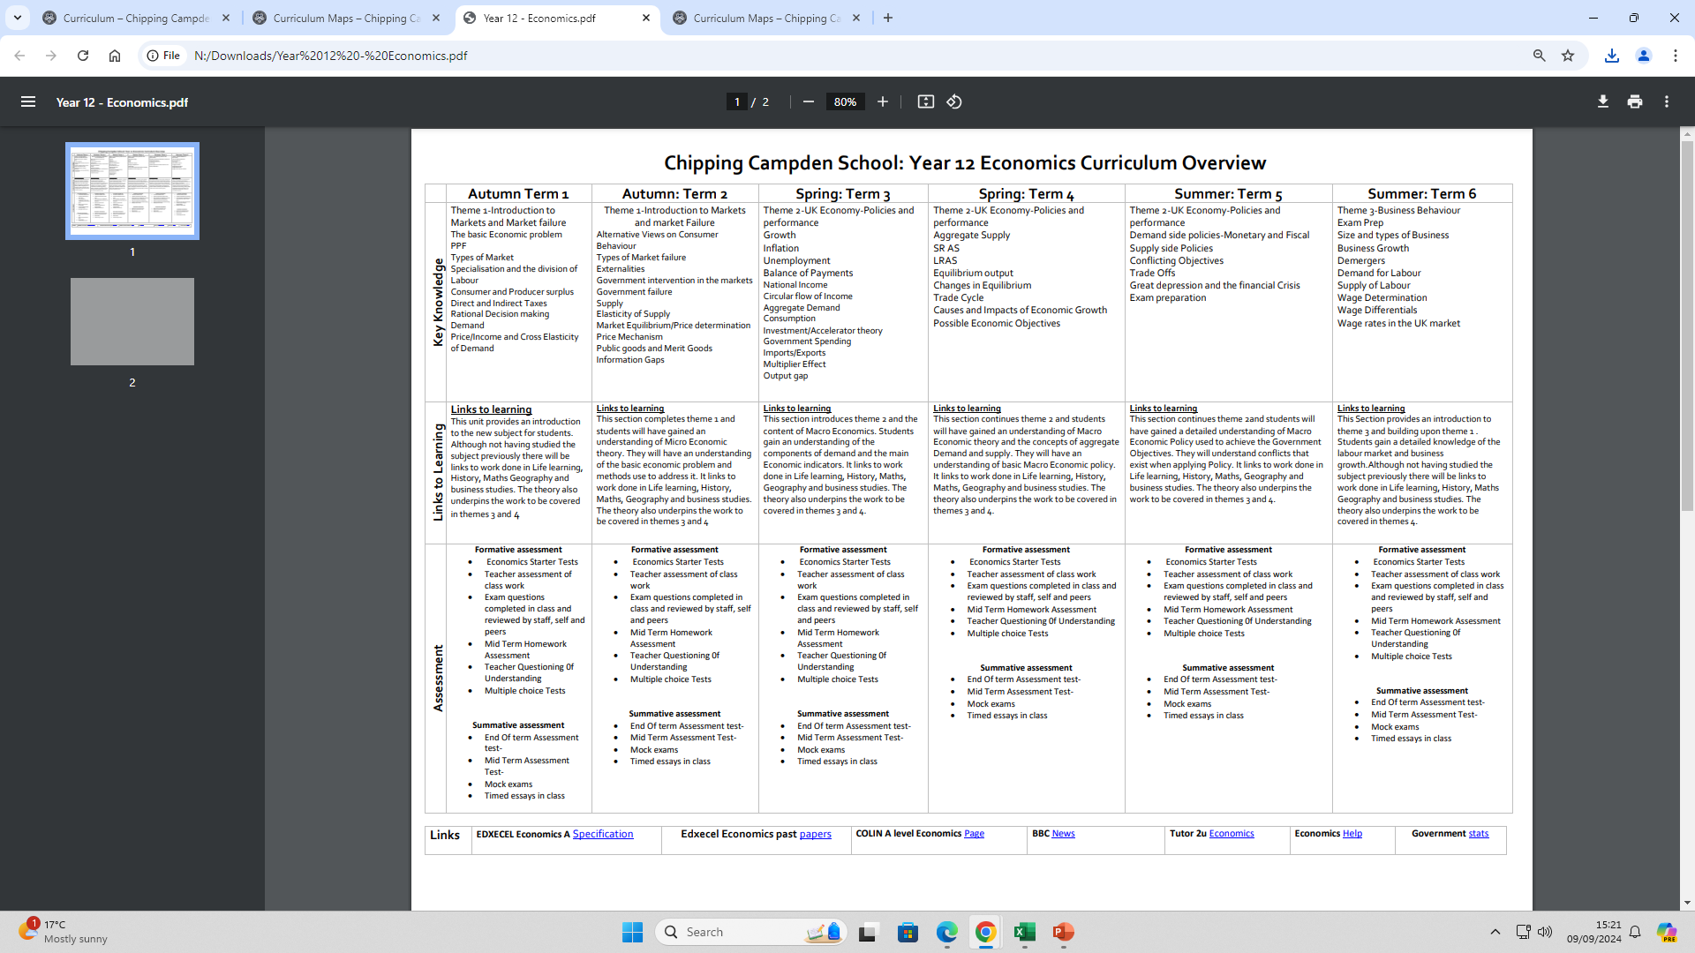

Slide 26
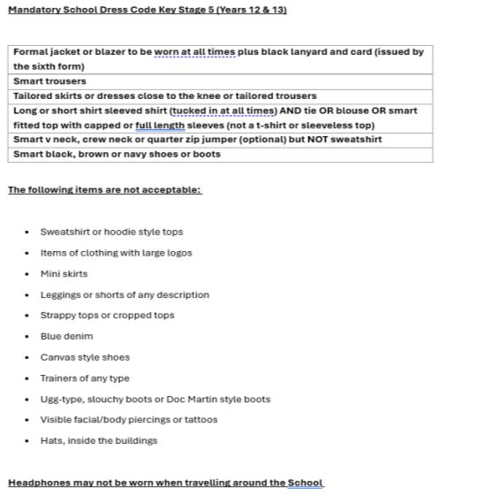

Slide 27
Sixth Form Dress Code
Sixth Form Uniform Dress Code – Additional Stipulations
Blazers The only items that may be worn under a blazer/jacket are a shirt, jumper and tie. Coats / Hoodies / sweatshirts may not be worn under blazers/jackets, either in school or going to and from it.
Belts - Black or brown, with plain buckle only.
Hair No extreme changes of hairstyles such as shaven sections or whole head; No spiky styles; Mohicans; obvious dyeing and unnatural colours. Hair wear should be discreet. Long hair should be tied back off the face.
Make-up The school discourages the use of make-up but if used it should be barely perceptible. Nail varnish is only permitted if colourless.
Jewellery No visible jewellery except where students wish to wear one plain set of earrings in each ear. No bracelets or hand jewellery. No visible facial jewellery or facial piercings of any kind to be worn in school.
General Appearance - The aim of the above is to focus on being dressed for learning and work. Consequently, the emphasis is on being clean, smart and tidy. Trousers must be worn appropriately on the waist; shirts must be tucked into trousers or skirts and ties worn correctly.

Slide 28
16-19 Bursary
Please remember that the School has a 16-19 bursary fund to enable some financial assistance to students whose access might be inhibited by financial barriers. The policy for the bursary is on the school website and the application form for consideration is attached. If you believe you are eligible for financial support and would like to make an application then please return the application form by the end of September and the decisions on the award will be communicated to you by the end of October.
All communications regarding financial support will be kept strictly confidential. Please send the applications to LDodgsonHatto@campden.school

Slide 29
CTech coursework marking policy
Updated to make process clear
Limited number of chances to improve/amend work
In line with national recommendations and practice

Slide 30
Tutor time
2 hours per week
Equivalent to half a subject
Time will be used in a more targeted way – not for routinely completing homework or socialising

Slide 31
The A-level Mindset (taught in tutor time)
“There is a growing body of research that suggests that successful students approach their studies with a specific set of behaviours, skills and attitudes and that despite not differing cognitively from their peers they can significantly outperform them.
In short, academic success can be as much about character as it is about intelligence”

Slide 32
Post 18 - preparation
As well as studying their subjects it is vital that prepare for life post 18
Know Before You Go

Slide 33

KS5 Parents/open eveUNIGning
Subjects Library: Students can explore HE topics that interest them, and related jobs in the Explore section. They can increase their knowledge of a subject in the Geek Out section.
University & Apprenticeships: Students can explore opportunities available to them after they leave KS5
Personal Statement: Any students applying to UK Universities will write a personal statement.
CV Builder: All students (and parents!) can use the CV builder tool to apply for job opportunities.
Post-18 Intentions: The more information students can give about their intentions for after leaving KS5, the better they can be supported at school or college.

Slide 34
Supercurricular
Not to be confused with extra curricular
Subject specific
Shows commitment and depth of learning
Eg work experience, volunteering, reading, attending courses, webinars, videos, student presentations
Identify reflections and subsequent actions

Slide 35

University landscape has changed in recent years
Decrease in number of foreign student numbers
University financial pressures
Advantages and disadvantages of university attendance

Slide 36
– University Application
All university applications to UK institutions
Deadline 14th January 2026 – applications after this date will be accepted, but may not be considered if the course is full.
Oxbridge, medicine, veterinary medicine/science applications deadline 15th October 2025
Students choose up to 5 options
Students receive offers (hopefully!) – accept firm and insurance and reject the others
Results Day – Thursday 13th August 2026
Clearing thereafter
If grades not achieved phone university directly

Slide 37
Apprenticeships
Increasingly competitive – many advantages and disadvantages
Apply directly to the company – no central service such as UCAS
Vacancies appear all year round
Unifrog and Gov.uk
4-6 years
Earn while you train and gain a degree
Usually a job offer at the end

Slide 38
Job/Career
The right choice for some
Earning
Trade/set of skills
Had enough of formal education (for now)

Slide 39
Gap Year
Part of a longer term plan?
Organised groups
Life experience if used wisely

Slide 40
A perspective on the post 18 world – The Guardian 13/7/25
Various people who shared their frustrations said that, across a variety of sectors, job-specific experience, especially in customer-facing roles, was now valued a lot more by employers than an impressive degree.
“I’m frustrated that I essentially got a degree because I was told it was the only good option and now I’m finding that I would have been better off entering the workforce straight out of college.”

Slide 41
“Being able to write well and think coherently were basic requirements in most graduate jobs 10, 15 years ago,” said a senior recruitment professional at a large consultancy firm from London, speaking anonymously. “Now, they are emerging as basically elite skills. Almost nobody can do it. We see all the time that people with top degrees cannot summarise the contents of a document, cannot problem solve.
“Coupled with what AI can offer now, there are few reasons left to hire graduates for many positions, which is reflected in recent [labour market] reports.”
“Various employers and professionals in HR and management positions shared that university leavers they encountered often struggled to speak on the phone or in meetings, take notes with a pen, relay messages precisely or complete written tasks without internet access.”
“What people want to do and what they’re actually good at are simply often two very different things…”

Slide 42
“My biggest fear is never being able to get into the field I want to be in,” said Louise, 24, who graduated from the University of Oxford with a master’s in microbiology last year and applied to hundreds of jobs while working part-time at John Lewis before she was recently offered a graduate trainee position.
The employer that hired her, Louise added, had been more interested in whether she had customer service skills acquired in hospitality jobs than in her scientific work experience and qualifications.
“The job I’ve been offered is not using the skills I have,” she said. “I just want to use my degree.”

Slide 43
Do your Research!!
Personal choice is important
There is no ‘ideal’ route
Help your child make an informed decision

Slide 44
Exam dates
Autumn assessemnts - week beginning 10th Nov for 1 week – in class
CTECHs – public exams begin 7th Jan for 2 weeks
Mock exams - week beginning 9th Feb for 2 weeks
Summer exams begin 5th May

Slide 45
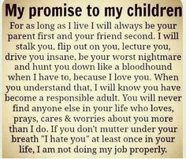
My reminder to students as to why you do what you do as parents………..

