Slide 1

THE UCAS PROCESS
AND STUDENT FINANCE
Jenna Page
Regional Schools, Colleges and Outreach Officer (South West)

Slide 2


REGISTRATION AND FIND OUT MORE
Register for the session and choose whether to opt in to receive more information.
Open Day dates, application tips, subject information and key date reminders.
Chance to win an Amazon voucher worth £50.
Terms and conditions apply. For more information, please visit www.southwales.ac.uk/schoolsandcolleges

Slide 3


WHY GO TO UNIVERSITY?
Average starting salary of £24,000
Graduates earn £10,000 more per year on average
Diverse career prospects
Pursue a passion
Internationally recognised qualification
Develop essential skills
95%
of USW graduates are in employment or further study within six months of graduation

Slide 4
THE UCAS PROCESS

Slide 5
THE UCAS PROCESS
Register an account with UCAS and link to school/ college
Start your application and start to write your Personal Statement
Submit application for review by school/ college BEFORE their deadline
UCAS DEADLINE: Wednesday 14 January 2026

Slide 6
THE VERY BASICS
Maximum of 5 choices...
Except...
Medicine, Veterinary Science and Dentistry
Oxford or Cambridge
EARLY ENTRY

Slide 7


3 questions: the only section you have total control over
2026 ENTRY
4,000 characters including spaces across 3 questions
Minimum of 350 characters per section
1 statement for all 5 of your choices
No spelling/ grammar check on UCAS system
Notes:
The new personal statement for 2026 entry | Undergraduate | UCAS
Graduates earn £10,000 more per year on average
Average starting salary of £24,000
Over 400 higher education providers in the UK
Over 65,000 undergraduate courses to choose from
2.86 million students studying at UK higher education institutions in 2021-22
Over 240 colleges offering higher education courses

Slide 8

3 QUESTIONS
What else have you done to prepare outside of education and why are these experiences useful?
Why do you want to study this course or subject?
How have your qualifications and studies helped you to prepare for this course or subject?
Notes:
These are for 2026 entry but are relevant to get 2025 entry thinking about what to include/answer in their personal statement.

Slide 9
THE UCAS PROCESS
Register an account with UCAS and link to school/ college
Start your application and start to write your Personal Statement
Submit application for review by school/ college BEFORE their deadline
UCAS DEADLINE: Wednesday 14 January 2026

Slide 10
UNIVERSITY OFFERS
Conditional Offer
(C)
Unconditional Offer
(U)
Unsuccessful application
(R)

Slide 11
RECEIVING OFFERS
Unconditional (U)– You're in!
Conditional (C)– You're in if you meet the conditions.
Conditions set for a university course could include:
Grade requirements
Auditions/ Portfolios
Admissions Tests
Interviews

Slide 12
RESPONDING TO OFFERS
Firm Acceptance (F)
Insurance Acceptance
(I)
Decline
(D)

Slide 13

CLEARING
AND
RESULTS DAY

Slide 14
RESULTS DAY-
WHAT HAPPENS NEXT?
You'll receive your grades
If you've met your conditions, you will get confirmation of your place on your chosen course
If you didn't meet the conditions of your firm choice, you may be offered, your insurance choice
If you don't meet the conditions for either you will be placed in Clearing

Slide 15


CLEARING
Did not apply in the initial UCAS cycle
Did not get the grades needed for firm or insurance choices
Would like to study a different course, or at a different university than the ones initially applied for
Did better than expected and would like to apply to universities with different entry requirements

Slide 16
STUDENT
FINANCE

Slide 17
STUDENT FINANCE
Tuition fee loan
To cover full fee charge
USW fees- £9,535 per year
Maintenance loan
To help cover living costs- including accommodation
Additional allowances
Including Scholarships and Bursaries
From Student Finance England
From Student Finance England
Notes:
Government funding is available to support your studies which consists of financial help for tuition fees and for living costs.​
​​
Some of the funding is via student loans and we will go through the protected repayment terms for these later in the talk ​
​
There is funding available for tuition fees and for living costs.​
​ As well as additional allowances which may be available for specific categories of students who have dependents or a disability.​
​
We’ll go through all of these in more detail in the following slides.​
Fee charges are £9000 per year for all full time undergraduate courses at a USW campus​
​
English domiciled students will have access to a non means-tested Tuition Fee Loan to cover their full fee charge. The fee loan is paid directly to the University and you only have to pay this back if you earn above the threshold after you finish the course. ​
​

Slide 18


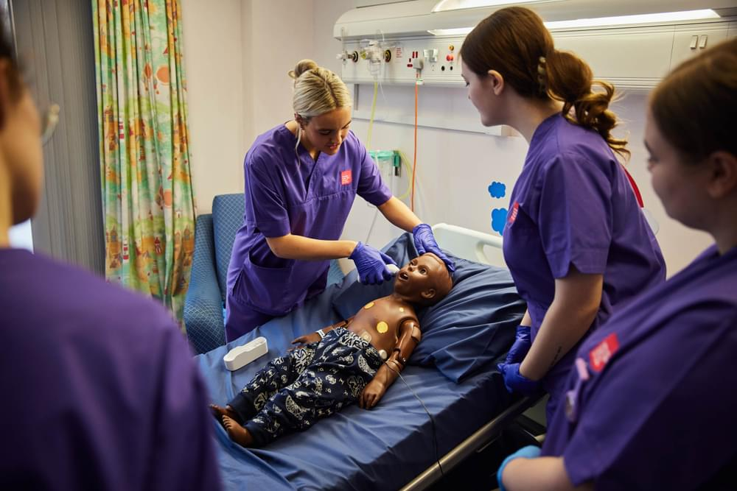
TUITION FEE LOAN
Available to all – up to £9,535
Not means-tested
Paid directly to the University
Notes:
Good opportunity to explain there are two parts to student finance – Tuition Fee (this slide) and Maintenance
Max. £6,165 loan for Private Providers

Slide 19



MAINTENANCE LOAN
Available to all but amount will vary
How much you can borrow will depend on your household income and where you live at university
Paid directly to the student
Notes:
Good opportunity to explain there are two parts to student finance – Tuition Fee (this slide) and Maintenance
Max. £6,165 loan for Private Providers

Slide 20
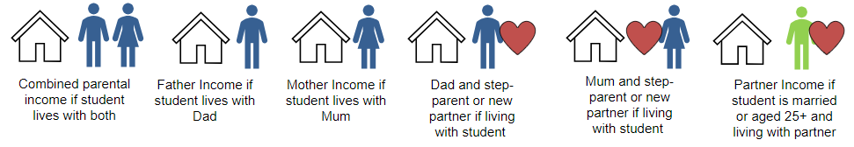

HOUSEHOLD INCOME
Household income is the total amount an applicant’s household earns each year before tax and national insurance
Based on taxable income
Independent student (supported themselves for 3 years or over 25) and single.
Single parents.
Note: Sibling are not considered in income
Notes:
Students classed as independent (with no parental or partners income to assess) would be assessed as having £0 household income and so get the maximum support.
Considerations for the audience presenting to

Slide 21




WHERE YOU LIVE
Parental Home
Elsewhere
London
Overseas
Notes:
Students classed as independent (with no parental or partners income to assess) would be assessed as having £0 household income and so get the maximum support.
Considerations for the audience presenting to

Slide 22
MAINTENANCE LOAN
Undergraduate students starting or continuing their courses in the 2025 to 2026 academic year will qualify for a 3.1% increase to maximum loans for living costs.
 | 2024-25 academic year | 2025-26 academic year
Living with your parents | Up to £8,610 | Up to £8,877
Living away- outside London | Up to £10,227 | Up to £10,544
Living away- in London | Up to £13,348 | Up to £13,762
Spending a year of a UK course studying abroad | Up to £11,713 | Up to £12,076
www.gov.uk/student-finance/new-fulltime-students
Notes:
Maximum loan amount goes to students on household incomes of £25,000 or less.
Minimum loan amount for students where household income is £58,307 or more​
​

Slide 23
MAINTENANCE SUPPORT
MAINTENANCE SUPPORT
HOUSEHOLD INCOME | LIVING AT HOME | AWAY FROM HOME (OUTSIDE LONDON) | AWAY FROM HOME (LONDON)
£25,000 or less​ | £8,877​ | £10,544​ | £13,762​
£30,000​ | £8,132​ | £9,791​ | £12,997​
£35,000​ | £7,387​ | £9,038​ | £12,231​​
£40,000​ | £6,642​ | £8,285​ | £11,465​
£45,000​ | £5,897​ | £7,532​ | £10,700​​
*above this earning threshold, living at home maintenance loan is capped.
Notes:
Figures are based on 2023/24

Slide 24
MAINTENANCE SUPPORT
MAINTENANCE SUPPORT
HOUSEHOLD INCOME | LIVING AT HOME | AWAY FROM HOME (OUTSIDE LONDON) | AWAY FROM HOME (LONDON)
£50,000​ | £5,152​ | £6,779​ | £9,934​
£55,000​ | £4,407​ | £6,026​ | £9,168​
£60,000*​ | £3,907​ | £5,273​ | £8,403​
£65,000​ | £3,907​ | £4,915​ | £7,637​
£70,040 & over​ | £3,907​ | £4,915​ | £6,853​
*above this earning threshold, living at home maintenance loan is capped.
Notes:
Figures are based on 2023/24

Slide 25
REPAYING YOUR STUDENT LOAN

Slide 26
STUDENT LOAN REPAYMENT
Students begin to repay their student loan when they are earning over the £25,000 per year threshold*
Students earning over the £ 25,000 threshold will begin repaying their loan the April after graduation.
Calculated monthly and based on income, not how much has been borrowed
Repayments are 9% of your income above the threshold and are automatically dealt with by the HMRC
If income drops below £25,000 repayments will stop
Interest is based on Retail Price Index, currently 4.3%
*This threshold will rise to £25,710 for students in 2027.

Slide 27
WRITTEN OFF AFTER 40 YEARS

Slide 28
STUDENT LOAN REPAYMENT
Income Each Year Before Tax | Monthly Income Before Tax | Approximate Monthly Repayment
£25,000 | £2,083 | £0
£28,000 | £2,333 | £22
£29,500 | £2,458 | £33
£31,000 | £2,583 | £45
£33,000 | £2,750 | £60

Slide 29
STUDENT DEBT

Slide 30
ADDITIONAL SUPPORT

Slide 31

DISABLED STUDENT ALLOWANCE (DSA)
Available in addition to the standard student finance package
Subject to an assessment.
Not repaid or affected by household income
Can receive up to £27,783 per year for costs e.g. photocopying, specialist equipment or to pay for a non-medical helper
Eligible disabilities could include:
long-term health condition
mental health condition
specific learning difficulty, such as dyslexia

Slide 32

ADDITIONAL FUNDING
English student funding amounts
Childcare Grant:​
Based on 85% of actual registered/approved childcare costs, subject to a​ maximum of £193.62 per week for one child or £331.95 per week for two or more children​
Parents’ Learning Allowance:​
Help with course-related costs for students with dependent children, the maximum amount is £1,963​
Adult Dependents’ Grant:​
Normally for the student’s partner or other adult financially dependent on the student. The maximum grant available is: £3,438​
Notes:
There are additional allowances that students who have dependants may be entitled to. Please note that all of these allowances are means-tested so household income will determine if you are entitled. ​
​​
If you have an adult, such as a partner or spouse, who is mainly or solely financially dependent on you, you may be able to receive the Adults Dependants Grant which is £3438 (SFE)​
​
If you have dependent children, you may be entitled to the Parents Learning Allowance which is £1963 (SFE).​
​
If you also use accredited or registered childcare provision, you can apply for the Childcare grant which looks to cover up to 85% of your childcare costs up to a maximum of:​
£193.62 (SFE) per week for 1 child​
£331.95 (SFE) per week for 2 or more children​
Essentially, you will be asked to estimate your childcare costs and then you/your childcare provider will be asked to provide evidence of your costs and payments will be adjusted as required and paid directly to them.​
​
If you are a single parent student, you would be entitled to the relevant amounts for Parents Learning Allowance and Childcare grant (if using registered childcare). If you live with a partner, their level of income would determine if you qualify. ​
Even if your partner is on a low income, we would advise you not to count on this additional funding but to apply to be assessed for it to see if you qualify. ​
​
There is also a Disabled Students Allowance available if you have a disability which means that you could incur extra costs in coming to study. The DSA is not means-tested but based on a students need. The Disability Service at the University would assist you to apply for the DSA and carry out a needs assessment. ​
​

Slide 33

SCHOLARSHIPS & BURSARIES
Every university offers them
Apply separately to your student finance application
Do your research
Notes:
Good opportunity to explain there are two parts to student finance – Tuition Fee (this slide) and Maintenance
Max. £6,165 loan for Private Providers

Slide 34

SCHOLARSHIPS & BURSARIES
Check out the host of scholarships and bursaries on offer to see if any apply to you including:
Welsh Medium Scholarships
Sports Scholarships
Ethnicity Equality Bursary
Sanctuary Schemes
www.southwales.ac.uk/study/fees-and-funding/undergraduate
Notes:
Check out our webpages to see if there are any additional bursaries or scholarships you may be eligible for, detailed information on the schemes and whether you need to apply, or be automatically considered.

Slide 35

HOW TO APPLY
English applicants apply via Student Finance England: www.gov.uk/studentfinance
Applications open each year in the spring before you start your course
Money is released once you enrol at your chosen university
Current application timescales are available online:
www.gov.uk/guidance/sfe-current-appication-timescales
Notes:
Applications usually open in the spring (March) before you start your course. Applying online is the easiest way to apply and our advice would always be to apply as soon as possible. ​
​
Application processing time is normally 6-8 weeks but can be longer at peak times.​
​
You should apply for your funding BEFORE you go to University even if you have not yet been accepted on the course. Put down your first choice University and course so that your funding can be assessed. If your University/course changes, you can log back into your online student finance account to amend this.​
​
You will need to provide:​
Financial details of household income relevant tax year​
Passport Number or Birth Certificate and accompanying form​
National Insurance Number​
Parents can set up their own online student finance account to submit their details​
​
​
NB You will have to complete a separate application for the Childcare Grant and the Disabled Students Allowance. The online application for student finance will ask you if you want to apply for these and will give you the appropriate instructions. ​
​

Slide 36
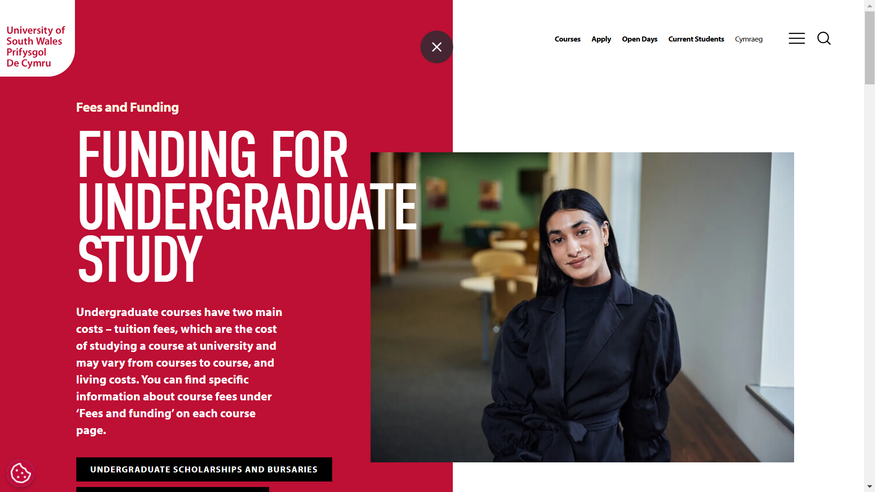
CONTACT US
For Information, Advice and Guidance
Tel:
01443 483778
Mon – Fri (9.00 – 12.00)
Email: money@southwales.ac.uk
Web: www.southwales.ac.uk/study/fees-and-funding
Notes:
Here are the contact details for the Student Money Advice Team if you require further support or information. A factsheet is also available with all of the information contained in this talk.​
​
Student Money can provide support via email or you can contact us for a telephone/Teams appt. We may also be available at a stand/via online chat at todays event (check timings).​
​
Diloch/Thanks​

Slide 37
OPEN DAYS
SATURDAY 14 JUNE
Book your place:
southwales.ac.uk/open-days

Slide 38

THANK YOU! DIOLCH!
Jenna Page
Regional Schools, Colleges and Outreach Officer (South West)

Slide 39


