Slide 1
For ASK partner reference
Before your session, please consider:
Adapting for your session This presentation has been designed broadly to support the national programme and ensure consistency of information and central messaging being shared. Whilst partners are asked to follow key messages and the general structure of this session, please do adapt the session as necessary to meet the needs of your audience and to localise/personalise the content for the session planned. Please therefore consider: The audience you are delivering to, including size of cohort, age group and for students with additional needs. The length of your session – please select priority content and hide/unhide slides depending on session timing, the audience and your delivery method e.g. face to face or virtual. Interactivity – please see the script and supporting guidance for ways to add interactive elements to the session (or add your own). How you can add in local examples and local labour market information where suitable/required (required are highlighted in yellow). The script is not designed to be read verbatim, but please familiarise yourself with key messaging. Access and links Please consider IT/internet access that may be required, particularly for live demos of any websites. Check any videos have downloaded to your device and are embedded in the slide should you wish to use them. Animation Animation has been applied to the slides so if you see any imagery layered on top of each other on slides, this will be why. Please check this works correctly for you in presenter mode.
Session timings
This session will roughly take between 15 – 30 minutes. Introduction (1-2 mins), what are apprenticeships (2-5 mins), levels of apprenticeships (2-5 mins), career starter/flexibilities/H&D (5-10 mins), meet apprentices (2-5 mins), key/facts (5-10 mins), roles and employers (2-5 mins), where to look (5-10 mins), next steps (2-5 mins)
This slide is hidden by default

Slide 2



Understanding apprenticeships
Version 1: September 2024
ASK PROGRAMME
2024/25
FUNDED BY THE DEPARTMENT FOR EDUCATION
Notes:
Hello / good morning / afternoon
My name is ‘insert name’ and I’m here today on behalf of the Department for Education to talk to you about apprenticeships.
As parents and carers, we know that you are keen to hear about all options available to your child so that you can support them in their decision making.
What we’re going to cover today is really important because even if your child does already know what they’re planning to do after school, plans can change and so it is important that they are aware of all of the options available to them so that they can make the most informed decision for them.
Apprenticeships have also changed significantly over the past few years and there are some brilliant opportunities available for your child. Through apprenticeships, you could now even achieve a degree if you wanted to, but I’ll tell you more about that in a few minutes.

Slide 3





APPRENTICESHIPS
Today’s session
WHAT THEY ARE
What we’ll be covering
ROLES & LEVELS
APPRENTICESHIP OPTIONS
SEARCH & APPLY
NEXT STEPS
Notes:
So, for the next 20 minutes, I’m going to explain more about:
Apprenticeships and how they work
The range of apprenticeship job roles available
The different levels
How you find an apprenticeship
What your child would need to do next to start searching and applying

Slide 4










What are apprenticeships?
A job with training
Level 2- degree level
Typically 1-6 years
Employed
Paid a salary
English/Maths if required
700+
standards
Real responsibilities
Not the easy option
Minimum 6 hours off-the-job
Notes:
So what is an apprenticeship?
An apprenticeship is a job first and foremost, with a real employer, where the apprentice will work full-time whilst also studying towards a qualification.
So you could be an apprentice working for Sky as a journalist, for example, whilst also studying and gaining a qualification in journalism.
CONTRACT
As it is a real job, apprentices are employed and will get a contract of employment, holiday pay, annual leave etc – exactly the same as any other member of staff.
LEVELS
You can do an apprenticeship from Level 2 all the way up to degree level now through apprenticeships, but I will come onto that in more detail shortly.
PAID A SALARY
As it’s a real job, you will earn a wage – and it can be a really good salary too! The salary of an apprentice can vary from employer to employer. Legally, an employer must pay an apprentice the National Minimum Wage for apprentices, which is currently £6.40 per hour. This is lower than the normal National Minimum Wage, but it recognises that some people will be going into their first job with little or no experience.
The good news is that lots of employers pay a lot more than the National Minimum Wage for apprentices, with some local employers offering starting salaries of £xx,xxx and other national employers even offering starting salaries over £15,000-£30,000.
I have pulled together some local vacancy information which I will show you in a little while, so you can see some real examples of local and national apprenticeships available and see what types of salaries are being offered.
It’s important to remember that if your child comes across an apprenticeship they’re interested in, to not be put off by the pay if it’s initially low: there’s room for progression and working your way to the top of an organisation and lots of employers will increase this as they achieve milestones during their apprenticeship.
TYPICALLY 1 – 6 YEARS
An apprenticeship typically takes 1 to 5 years to complete (sometimes up to 6 for some areas like a Solicitor). All apprenticeships must last for a minimum of 12 months.
The total duration will depend on the delivery model that the employer selects (how the mixture of training and working is delivered), the level and the subject they are studying.
ON-THE-JOB AND OFF-THE-JOB
The apprentice will spend the majority of their time ‘on-the-job’ (doing their role), and a minimum of at least 6 hours per week ‘off-the-job’, which means studying or working towards their qualification.
This study element (off-the-job) would take place with a training provider, who will help them to achieve the qualifications and make sure they complete their apprenticeship.
Training providers could be colleges, universities or independent training provider organisations, who deliver the training/teaching element of the course.
The employer will also support the apprentice, helping an apprentice to gain qualifications and valuable new skills and experience. As well as their time, employers also pay the fees of the apprentice’s training, showing their investment in the apprentice’s development.
ENGLISH/MATHS
Apprentices can also be supported to gain English and Maths qualifications, if required, through their apprenticeship.
700+ STANDARDS
The apprentice will work towards an apprenticeship standard, and these are designed by employers to ensure that the apprentice will gain the skills, knowledge and behaviours they require for the role. There are more than 700 different apprenticeship standards available now, ranging across different sectors (which we will explore shortly).
REAL JOB = RESPONSIBILITIES and NOT THE EASY OPTION
As I said before, it’s a real job and so it’s important to remember that apprenticeships aren’t the ‘easy option’. Holding down a full-time job and studying takes a certain skill and commitment, and it won’t be right for everyone.

Slide 5
Levels of apprenticeships
Intermediate
Advanced
Higher
Degree
Equivalent to:
5 GCSE passes at grade 9-4 (A*-C)
Equivalent to:
2 A levels /
International Baccalaureate
Equivalent to:
Foundation degree and above
Equivalent to:
Bachelors or
masters degree
Level 2
Level 3
Levels 4-7
Levels 6 & 7
Notes:
Each apprenticeship has a level which will falls into one of the four categories above: Intermediate apprenticeships, Advanced apprenticeships, Higher apprenticeships and degree apprenticeships.
The ‘equivalent to’ text helps to explain what level the qualification at the end of the apprenticeship will be in comparison to more familiar qualifications, like GCSEs and A Levels.
So you can see that if you do a Level 2 (intermediate) apprenticeship, once you have qualified, you’ll gain a qualification that is equivalent to 5 GCSEs..
For Level 3 (advanced apprenticeships), this is equivalent to 2 A Levels, a T Level, a Level 3 diploma or other equivalents, like IB’s or BTECs, for example.
Levels 4-7 is then used to group higher apprenticeships, but what we do find is that most people when they talk about higher apprenticeships mean levels 4 and 5, and when they talk about degree apprenticeships, they mean level 6 and level 7.
So a higher apprenticeship at level 4 is equivalent to a foundation degree at University (the first year).
Levels 5 and 6 are degree level apprenticeships and level 7 is masters level.
Presenter note: Opportunity to pause to ask if there are any questions about levels and how they work.

Slide 6
Levels of apprenticeships
Intermediate (L2)
Advanced
(L3)
Higher
Degree
Furniture maker
Security operative
Barber
Aviation ground handler
Dog groomer
Florist
Accounts assistant
Pharmacy assistant
Marina operative
Junior estate agent
Engineering technician
Pastry chef
Multi-channel marketer
Fudraiser
Scenic artist
Electrician
Community wellbeing worker
Data technician
Visual effects artist
Town planning assistant
Sports coach
Space engineering technician
Geoscientist
Accounting manager
Midwife
Pilot
Social worker
Civil engineer
115 standards (L4)
110 standards (L6)
Vet technician
Nursing associate
Rail engineer
Marine pilot
Nuclear technician
Doctor
Game programmer
Play therapist
Solicitor
Economist
141 standards
239 standards
41 standards (L5)
66 standards (L7)
Notes:
Presenter note: Please edit this slide with any other apprenticeships that you feel are relevant. Please also remove this slide if you are short on time in your session.
This is just an example of some of the different apprenticeships you can do at different levels, and how many apprenticeships are available at those levels.

Slide 7


Apprenticeships - Key facts
Levels not linear - dependent on role and experience
Majority of starts in U19s were Intermediate & Advanced
Employer led - apply to employer, they select the provider
Different recruitment methods
Entry requirements vary
Employer decides when they advertise
Notes:
Now that we’ve talked about levels, it’s really important to note here (as this can often be where we see a lot of confusion around apprenticeships) is that the level of apprenticeship you start at will depend on the kind of job that you are applying for.
LEVELS
Apprenticeships work a bit differently to full-time education in that they will not always be linear, which can be confusing for students who may think that they should progress onto the next level when they finish school e.g. if you leave after GCSEs you should do a Level 3 and if you finish after A Levels you should go for a degree apprenticeship, but this isn’t always the case.
This can be for a few reasons.
Firstly, it could be around employer/industry requirements. Depending on the sector and apprenticeship, it may be that they need to start at advanced or higher level and work their way up, or that brilliant apprenticeships are only offered at Level 2 or 3 – for example, an estate agent apprenticeship is only offered at Level 2 because that is all the industry requires, or a teaching assistant at Level 3.
Equally, your child may be entering a completely new sector or industry that they haven’t studied or worked in before, and so may need to do a Level 2 or 3 to enter the world of work, get their foot in the door with the employer and get that basic entry understanding of the role, the requirements, the employer and the sector first. For example, working as a healthcare assistant within the NHS/a hospital before going straight into a nursing degree apprenticeship with no previous knowledge/experience.
So it really does depend on the role and sector requirements.
If they would like to then progress through the levels and move into a higher or degree apprenticeship, they would have greater foundation knowledge and expertise which would hopefully help them to feel really confident in completing a higher-level qualification whilst working.
It is therefore very important for them to keep an open mind about apprenticeship levels, and not narrowing down their options to degree apprenticeships only, for example. We have seen a spike in interest in degree apprenticeships, which is understandable as they are a fantastic offer, but there are different pathways into different careers an so it is important that they explore all of the opportunities available so they have multiple options when applying.
The data from apprenticeship starts over the last year (2023/24) does also show that the majority of starts for young people aged 16-19 were on to Intermediate and Advanced apprenticeships, so we’re not saying to not encourage your child to aspire for degree apprenticeships as they are brilliant, but what we need to talk or think about is that realism that what employers are showing us is that the majority of positions that they have in their organisations for apprentices are not necessarily at degree level at the beginning.
EMPLOYER LED
We have already discussed that apprenticeship standards are designed by employers, and it is important to also note that they are the organisation offering the vacancy, so they will have a role in their organisation that they would like to recruit apprentices to. They will then select an apprenticeship training provider to work with to offer the apprenticeship.
So for example, with degree apprenticeships, we sometimes hear students asking how they might get a degree apprenticeship with a particular University, or who may be interested in an apprenticeship with an employer but want to know how to do that with a different University or provider, which isn’t the case for apprenticeship.
The employer will have decided which university or college or independent provider they will work with depending on what works best for them around type of delivery (online/in-work/on-site), timing (block weeks/days), quality, ways of working etc.
PROCESSES VARY
It is also important to note that recruitment processes vary, as they would with other jobs. So some employers may have quite a lengthy, in-depth process and others may ask for a CV and interview only. It depends on the employer.
Likewise, entry requirements vary. Some employers may have minimum grade, others may not ask for grades at all and will be looking for skillsets and potential, so it’s important to read through the job description information.
We have also come across some young people before who have only applied for one or two Higher and Degree apprenticeships after their A Levels, but unfortunately have not achieved the entry requirements for that role and so cannot do the apprenticeship, so it is important to read these and have a variety of options.

Slide 8


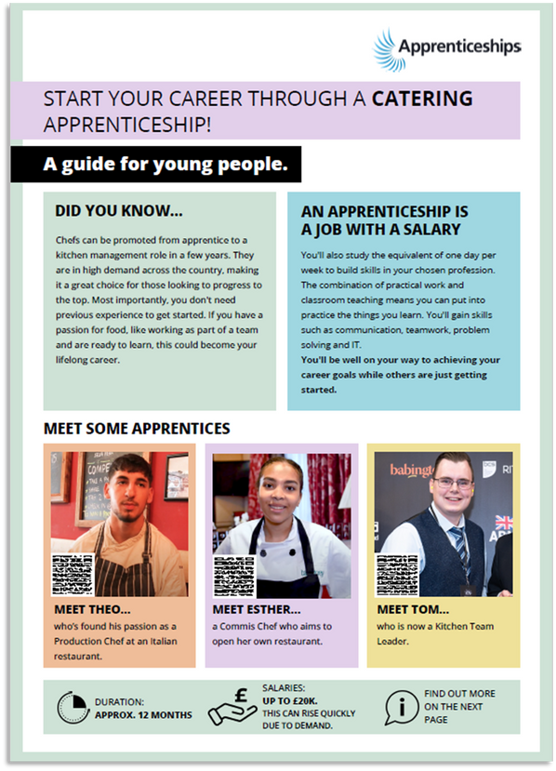
Career starter apprenticeships
Bricklayer, Plasterer, Electrician, Engineering Fitter, Plumber, Horticulture or Landscape Construction Operative
Chef, Hospitality Team Member
Business Administrator, Content Creator
Cyber Security Technician, Digital Support Technician, Data/Software Technician, Information Communications Technician
Early Years Educator, Teaching Assistant
Dental Nurse, Healthcare Support Worker
Freight Forwarding Specialist, Warehouse Operative
Notes:
Presenter note: Please consider hiding/unhiding this slide depending on the time available in your session and the audience.
With so many different roles and sectors available to do an apprenticeship in, it can be difficult to know which role might be the best for you and how to best enter that sector.
The Department for Education have launched ‘Careers Starter Apprenticeships’, where they have identified apprenticeships that can help to launch your career in a sector. You can do these as your first role after leaving full-time education and then work your way up, either through apprenticeships (all the way up to degree level), or through the organisation you work for.
Each of the Career Starter Apprenticeships are Level 2 or 3 apprenticeships, and so can help you to enter that sector after you have left school or college.
If you are already completing a Level 2 or 3 course (e.g. GCSES, A levels, a T Level, BTECs or another level 3 course), then you can still do a Level 2 or 3 apprenticeship as long as it is different to what you have previously studied. It is a fantastic way to enter the world of work if you may not have had much previous experience and you are learning how to do a new job in a new industry (as we discussed earlier).
The DfE have produced two-page guides for each of these apprenticeships, with lots of valuable information and interesting case studies from apprentices in these roles.

Slide 9









Higher & Degree apprenticeships
University fees paid by employer and/or Government
Work full-time and study part-time
No debt
Integrated degree or degree level
Experience
4-6 years
100+ universities (plus colleges, training providers)
Competitive
Progression
Required
Employer selects University/provider
Notes:
Presenter note: Please consider hiding/unhiding this slide depending on the time available in your session and the audience.
Higher and degree apprenticeships are a real alternative to following the traditional route of going to university as a full-time student.
They offer the benefits of higher education without the cost and the opportunity to work and gain experience.
It important to remember that no route is better than the other (H&D apprenticeships or full-time University), it is just about which is best/right for you. Everyone has different learning styles and both routes offer a different way to learn and start your career, as well as other life experiences in different ways.
And so we’re going to quickly cover what higher and degree apprenticeships are and how they work so that you have an understanding of what is involved, in order to support your child in making the best decision for them.
With higher and degree apprenticeships, they work in the same way as other level apprenticeships.
You will not only be learning, but earning a salary from day one, just studying at a level 4 or upwards.
With a degree apprenticeship, your tuition fees are paid for by your employer and the Government, so you will not be expected to pay the £9000 a year tuition fees – and so you will not get any debt.
There are integrated degree apprenticeships (which designs the apprenticeship assessment as a part of the degree), and non-integrated degree apprenticeships where you work towards an existing degree that meets the knowledge requirements of a job. Both mean you come out with a degree level qualification.
You will study the same course content as if you were at university full-time, but are able to put it into practice in the workplace straight away while also learning from colleagues. This also helps you to stay up to date on the latest trends and technology in the sector.
With an apprenticeship, it can also be a benefit that you have gained at least 3 years’ work experience whilst completing your degree, which can give you a competitive advantage when applying for future jobs.
But it is hard work as a degree apprentice. You’ll be working full time and fitting in the equivalent of a full-time degree alongside. It might take a bit longer than studying full-time – for example, 4 years instead of 3, but you’ll achieve the same degree. Some can take as long as 6 years (for example, solicitor apprenticeship).
More than 100 universities in England offer degree apprenticeships now, but there are also colleges and other training providers who will offer apprenticeships.
The employer will select the University, college or training provider that you would study with, this would not be by selection of the apprentice. This will be based on what works best for the employer and will be selected prior to the apprenticeship starting, so as I noted before, it is important to keep an open mind about this and search for the best employer and role as opposed to which training provider they work with.
The students on degree apprenticeships are entitled to exactly the same benefits as other students, so you will still have access to the student union, sports facilities, clubs, societies and student discounts, as and when this is appropriate.
So there are lots of benefits that come with higher and degree apprenticeships, but as we have said, what works best for your child will depend on their career aspirations, the role, how they like to learn and what may be important for them around their next steps.
No matter what kind of career they want to follow, they need to do their research and find out if there’s a way to get to the role they want through an apprenticeship. That way, they can decide if they would prefer to study full time at college or university, or if they would prefer to go into work as an apprentice and gain qualifications and experience on the job from day one.
It is important to note that they can be very competitive. Higher and degree apprenticeships are becoming more and more popular because of all of the benefits, so there is lots of interest from young people and others.
So school/college leavers absolutely can apply for degree apprenticeships and you’ll see many brilliant young people achieving them, but as we discussed earlier, it’s important to keep your options open and consider routes through apprenticeships also e.g. starting at a level 2 or 3 and progressing into a degree apprenticeship.
We would encourage students to keep their options open and if they are not sure which route they want to take, apply for all options. If that includes university and apprenticeships, you can apply for apprenticeships alongside applying for university – both on the UCAS website and on other sites – which then gives them the opportunity to make the best decision for them once they have all their offers back.

Slide 10





Flexibilities in apprenticeships
Part-time
Flexi-job
Accelerated
Bursary
Notes:
Presenter note: Please decide if this slide is applicable for your session and hide this slide if you do not plan to include this content. Please also adapt the content on the slide for what information will be most suitable to the audience.
The government and employers are keen to make apprenticeships accessible for everyone, so different models are designed to suit different circumstances.
Part-time
Apprenticeships are also available if you work part-time (i.e. work less than 30 hrs/week) with the duration of the apprenticeship extended. For example, for a part-time apprentice working 15 hrs/week, who is following a typical 12-month apprenticeship standard: the duration would be extended to 24 months. You may consider a part-time apprenticeship if you caring responsibilities, for example, or other circumstances where a part-time apprenticeship may be more suitable.
Flexi-apprenticeships
In some apprenticeships, you can move between different businesses during the same apprenticeship.
Flexi-Job Apprenticeship Agencies – in this type of apprenticeship, an agency employs the apprentice directly for the duration of their apprenticeship and arranges placements for the apprentice with host businesses.
Portable Flexi-Job Apprenticeships – a type of apprenticeship being piloted in jobs with less predictable employment patterns such as theatre work. Apprentices move between different employers across an apprenticeship, pausing and restarting their apprenticeship as needed – currently offered in the creative, digital, construction, and health sectors.
Career progression and acceleration
When an apprenticeship is reduced in duration by at least 3 months, it is an Accelerated Apprenticeship. (Unlikely for school leavers)
Accelerated Apprenticeships support career progression for individuals no matter where they have built up their prior learning - both those who have experiential learning from career or life experience and those who have prior learning from previous completed apprenticeships, qualifications, and other skills programmes such as T Levels and Skills Bootcamps. There is information about where acceleration is available after T Levels on IfATE’s website- see: https://www.instituteforapprenticeships.org/qualifications/t-levels/
Accelerated Apprenticeships are not advertised - you find out if your apprenticeship will be reduced in duration before you start the apprenticeship when your employer and the training provider assess your existing knowledge and skills (during the initial assessment).
Bursaries
If you’re care experienced, you could be entitled to extra support during your apprenticeship, including a bursary up to £3,000, which you should be eligible for around 3 months after starting your apprenticeship to support you.

Slide 11






Meet some apprentices
Samuel - Level 2
Credit Controller
Alicia- Level 3
Digital Marketing
Anna - Level 4
Marketing Executive
Kelbydiamond - Level 5
Nursing Associate
Parris - Level 6
Software Engineer
Josh - Level 7
Solicitor
Notes:
Presenter note: Please adapt this with any other examples or local examples that are relevant. This can also be hidden if the film is being used on the following slide.
We’ve spoken about the different levels of apprenticeship, from levels 2 to 7, with a look at the career starter standards and then degree apprenticeships.
Here are some real apprentices at each level, and the apprenticeships they are undertaking – which just gives a different snapshot of the types of roles available.

Slide 12
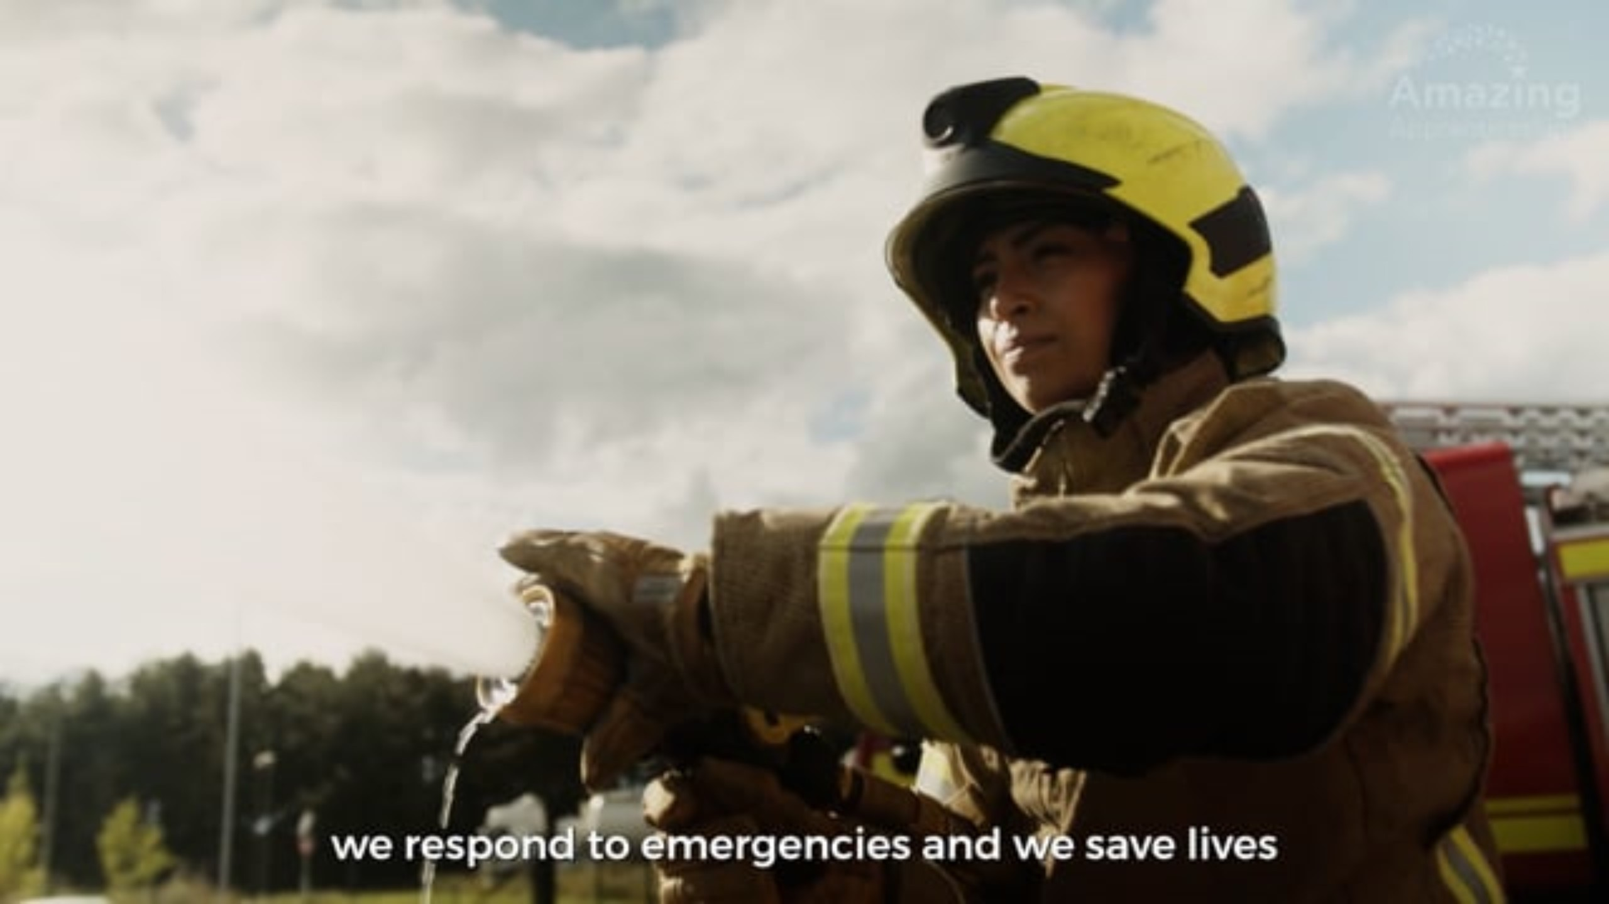
Meet some apprentices
Notes:
Presenter note: Please make sure the film selected is downloaded and embedded into the slide. We have included the below 1.5 minute film which showcases a range of apprentices in different roles, but please replace this with an alternative film should this be more applicable.
Amazing Apprenticeships ‘Apprentices are Amazing’ film – https://vimeo.com/613415806
We’ve covered quite a lot there already so I’m going to play you a short video now featuring a range of apprentices/apprentice name, who can bring this all to life a bit more by sharing their story/stories of how they’re finding their apprenticeship and what they are doing.
Presenter note: Please update the film included as you see best for your audience. For example, including a video of a local apprentice, including a World Skills Champion case study film or identifying a STEM apprentice or other suitable role model for your audience. Some suggestions have been included below:
Amazing Apprenticeships ‘Apprentice Story’ films - https://amazingapprenticeships.com/apprentice-stories/
Understanding apprenticeships _ Full version (4m 41s) https://vimeo.com/151121127
Technology apprenticeships for the new generation (4m 22s) https://vimeo.com/158818858
Higher and degree apprenticeships – make them your plan A (2m 58s) https://vimeo.com/173753735
AAN story videos - https://www.apprenticeships.gov.uk/influencers/apprentice-ambassador-stories
World Skills UK ‘Skills Champion’ films - https://www.worldskillsuk.org/

Slide 13

Did you
know?
Notes:
There are lots of myths about apprenticeships, because they have changed so much in the past few years, and therefore different concerns for you as parents and carers may come to mind for apprenticeships.
So I wanted to discuss some of these with you today.
Presenter note: Suggested interactivity: This is a good opportunity to open up the discussion to Q&A with parents and ask them to share their questions about apprenticeships and some of the different myths they may have heard that they’re unsure about. Or you can click on to follow the script with some FAQs.

Slide 14








Are they a good option?
Vacancies
Retention
Progression
Real job
97,150 on Faa Aug 2023 - Jun 2024
90% of apprentices stay in employment
Progression opportunities
Developing vaccines
Interviewing politicians
Designing goal-line technology
Employer value
Relocation
Support
Competitive
Notes:
Presenter note: Please add in any other relevant responses to queries you may be picking up from other sessions and answer those questions here.
LACK OF VACANCIES
One of the biggest concerns we have heard from parents is that there aren’t any jobs/vacancies available.
We have seen vacancies go back up to pre-pandemic levels and so there are lots of vacancies available, but they may be advertised widely across different platforms and at different points in the year.
Over the last academic year, there were over 97,000 vacancies available to apply to on Find an apprenticeship alone, with many more thousands advertised across other websites. However, there is lots of work being done to try and increase this further, particularly for entry level roles.
There is also lots of work being done to try and raise awareness of where vacancies are being advertised, with web alerts, vacancy newsletters, social media and resources.
NO PROGRESSION
One of the concerns we often hear from parents about apprenticeships is around the progression opportunities and whether it’s true that the employer will let the apprentice go once they have completed their apprenticeship. This is not the case, in fact the majority of apprentices (around 90%) stay in employment. If they do change companies, it’s usually because they’re able to compete for a better job, perhaps with more pay or more responsibility.
It also isn’t true that apprentices can only get to a certain level within an organisation, as their qualification is valued less than a degree for example. We come across employer after employer where they tell us that their Director started off their career as an apprentice, or that their apprentices are now managing their graduate peers because they have the in-work experience and so can guide the graduate cohorts on the ways of working.
So there really is no limit for apprentices, with their combined experience and knowledge, they are highly valuable employees that the employer has invested in (both financially and with their time) in training and upskilling them, so they do want to keep those individuals.
Presenter note: This may be a good opportunity to include a local/national example or case study.
NOT A REAL JOB
Another common myth is that apprenticeships are not real jobs and that the apprentice is just used to make the tea and do the menial tasks. This is certainly not the case – we will shortly be discussing the different roles available through apprenticeships, from solicitors, to aerospace engineers, to cyber security analysts to midwifes – and all of these apprentices are working from day one of the apprenticeship, learning on the job how to fulfil that role and building their skills and knowledge. Apprentices are contributing to incredible projects and work all over the country. Some examples include: - Apprentices working on vaccines such as the Covid vaccine - Apprentice, Akeem (Broadcast Engineer with the BBC) filming the final interview with Theresa May in Downing Street - Apprentices working on the goal-line technology for football
Presenter note: Suggested to use a personal example here where you know an apprentice or AAN and what their job role is.
EMPLOYER VALUE
We also often get questions from students or their parents who have worries that employers don’t value apprentices as much as they do graduates. Apprentices are valued just as highly, as they have qualifications and direct experience of the workplace.
RELOCATION
One of the best things about apprenticeships is that they are everywhere. So if your child wants to carry on living at home then they can, but they can sometimes move around the country with an apprenticeship. This is not standardised like it is for University, but some companies will help them to relocate to work for them, particularly if they are more rurally based, or it just may be that the salary and package allows your child to do so. So it’s really important they do their research.
NO SUPPORT
Another concern that we sometimes hear from parents is that they’re worried there isn’t as much support available for their child through an apprenticeship that they might get at college or university, for example, where they might have a dedicated tutor or additional support staff helping them, for example. The positive thing about apprenticeships is the network of people around apprentices trying to help them to succeed.
From their line managers, mentors or colleagues at work who will be training them and supporting them in their role, to the tutors and staff at the training provider, there should be lots of support available for the young person. Many employers and providers also offer lots of other supportive initiatives and networks, such as apprentice networks, community networks or mental health and wellbeing support, for example.
COMPETITIVE
Apprenticeships are competitive, but there is lots of support available to help your child to prepare for the application process and make sure that they stand out.
Presenter note: Suggested interactivity: Open this up for Q&A with parents to dive deeper into the discussions:
Are there any other concerns you have as a parent that you’d like to share?
From what we’ve discussed already, is there anything you’d like to discuss in more detail?
Another example may be social impact/network
Another concern for some young people that we hear is that they are worried that as an apprentice, they won’t get to have fun or meet other young people.
Depending on the size of the company, they may find themselves working with lots of other young people, or they may meet them through their apprenticeship training. Lots of employers and training providers try to offer ways for apprentices to connect with each other, through social events, team activities, networks and other support.
Some bigger employers, for example, have helped their apprentices who are re-locating for work to link up with other apprentices who are re-locating and find shared accommodation.
They can also join a number of different apprentice networks, including the Apprenticeship Ambassadors Network, where they will meet and connect with hundreds of other apprentices.

Slide 15












Range of apprenticeships
First Officer Pilot
Paralegal
Quantity Surveyor
Dietician
Aerospace Engineer
Paramedic
Visual Effects Artist
Architect
Zookeeper
Ecologist
Business Administrator
Chef
Notes:
Presenter note: Please add in some local opportunities to the slide above (a mixture of traditional and non-traditional job titles) to also bring the range of the local offer and facilitate discussions below.
We’re now going to take a look at the different job roles available through an apprenticeship and when we talk about apprenticeships, people often start to think of Plumbing, Electrical and some of the other construction trades. There are many brilliant apprenticeships in these areas, but there are also hundreds of new apprenticeships in exciting areas that you might not know exist.
The range of apprenticeship job roles out there is amazing.
This slide gives you an idea of the huge range of apprenticeships available and this is just a taster – there are now over 700+ different apprenticeship standards available, resulting in over 1,500+ different job roles.
You could start an apprenticeship in hundreds of occupational areas. Some will amaze you!

Slide 16




































Range of employers
Notes:
Equally, the range of employers offering apprenticeships is incredible.
This slide shows you some really familiar logos of big companies in England who all recruit apprentices. This is just a snapshot, but there are excellent brands with amazing apprenticeship opportunities.
Some of these employers may not be recruiting currently, but you will be able to track their recruitment updates on their websites or social media.
Around 50% of apprenticeships started are with large companies like this, but 50% will be with smaller local companies.

Slide 17













Range of employers
Notes:
Presenter note: Include examples of a local company in the town that you are delivering in and add their logo to the slide. An example of a small local company is…X who employs apprentices in job roles like X and X etc.
It can be tempting to think that the ‘best’ apprenticeships are just with the big, well-known companies, but many of the smaller employers have absolutely brilliant schemes that enable fast-track career progression for their apprentices, so it’s really important to do your research and not to ignore smaller employers because they can be just as good.
The logos on screen showcase some of the employers that were selected within the Top 50 Small and Medium Apprenticeship Employers in England, as well as some local companies that offer apprenticeships in your area …

Slide 18
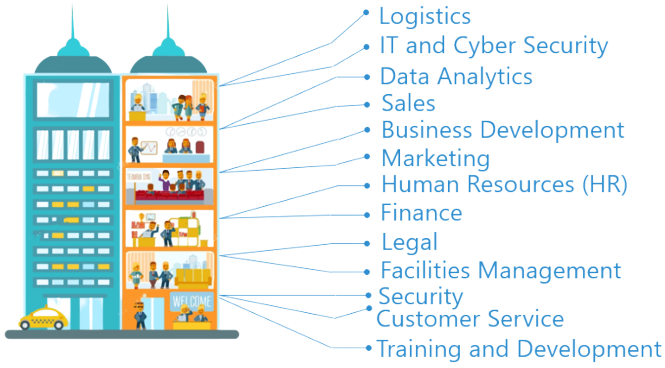
Look inside the company
Logistics
IT and Cyber Security
Data Analytics
Sales
Business Development
Marketing
Human Resources (HR)
Finance
Legal
Facilities Management
Security
Customer Service
Training and Development
Notes:
They will also need to think about the different roles that a company might have.
For example, if they want to work in finance – they shouldn’t just look at the big finance and accountancy companies. Lots of other companies will have their own in-house finance departments where they would still have access to a huge range of experiences and opportunities.
It can be a good idea to take some time to look at the different departments that a company has and see if they offer an apprenticeship in that area.
For example, your child could work as a solicitor for Coca-Cola, a website designer for Vauxhall, as a Cyber Security apprentice for the Government. There are thousands of different opportunities!
Presenter note: Please update the example if you feel that mentioning Vauxhall or Coca-Cola is not representative of your area.

Slide 19

Are there vacancies?
Radius
Number of vacancies
5 miles
x
10 miles
x
15 miles
x
20 miles
x
England
x
Notes:
Presenter note: We would expect this slide to be updated by the delivery partner to reflect local opportunities by searching through Find an Apprenticeship.
So as I said before, I had a look on the Find an apprenticeship website before coming along today so that I could see how many vacancies are out there at the moment.
If you notice, within 5 miles of this school/college today, there are xx vacancies.
You can see how this number grows the more you increase the distance.
Your child will need to think about how far they are able to/ are prepared to travel for work each day.

Slide 20
Apprenticeships in the local area
Job opportunity | Closing date | Level | Annual salary
Technical Coordinator Apprentice DAIRY PARTNERS LIMITED | 1st Feb | 6 | £30,000
Various RAF | 25th Aug | 3,4 and 5 | Up to £33,100
UK 2025 MES Network Engineer Apprenticeship VODAFONE LIMITED | 1st April | 6 | £24,640
Business and engineering Apprentice KOHLER MIRA LIMITED | 17th Feb | 5 and 6 | £17,000- £20,000
Notes:
Presenter note: Please update this slide with relevant examples for your audience.
Search through Find an apprenticeship using the establishment postcode and find some interesting jobs.
Try to find a selection of closing dates so that you can reinforce the need to be using Find an apprenticeship regularly.
Try to find a range of salaries so that you can show that there are employers who are prepared to pay more – often highlighting salaries can be high at all levels, not just degree apprenticeships.
Try to find a job title that might sound a bit confusing and then explain what that role really is – make it sound exciting and explain that they should not be put off by the titles of some jobs, it’s important they read the job advert attached to it.
Think about STEM vacancies. Can these be showcased more?
This slide shows a range of vacancies that I could find.
You will notice that they all have different closing dates – this is one big difference to applying for university.
If you do see a closing date, it’s important that you don’t wait until the very end to submit your application. We are finding from talking to employers, that if they receive a huge number of applications, they may decide to close the application window early.
You will also notice the range of different salaries too – this is because employers can decide what to pay (as long as it meets the national minimum wage for apprentices of £6.40)
Presenter note: It might be useful to have the find an apprenticeship website open to show them current examples and what the site looks like. This is also relevant for the next slide.

Slide 21
Apprenticeships in the local area
Job opportunity | Closing date | Level | Annual salary
All Apprenticeship GE Aerospace | 24th Nov | 3 and 6 | Up to £22,000
Various RAF | 25th Aug | 4 and 5 | Up to £33,100
Audi Service Mechanic Apprentice | 3rd Dec | 3 | £13,312
Broadcast and Media Systems Engineer BBC | 28th Nov | 6 | 21,840
Notes:
Presenter note: Please update this slide with relevant examples for your audience.
Search through Find an apprenticeship using the establishment postcode and find some interesting jobs.
Try to find a selection of closing dates so that you can reinforce the need to be using Find an apprenticeship regularly.
Try to find a range of salaries so that you can show that there are employers who are prepared to pay more – often highlighting salaries can be high at all levels, not just degree apprenticeships.
Try to find a job title that might sound a bit confusing and then explain what that role really is – make it sound exciting and explain that they should not be put off by the titles of some jobs, it’s important they read the job advert attached to it.
Think about STEM vacancies. Can these be showcased more?
This slide shows a range of vacancies that I could find.
You will notice that they all have different closing dates – this is one big difference to applying for university.
If you do see a closing date, it’s important that you don’t wait until the very end to submit your application. We are finding from talking to employers, that if they receive a huge number of applications, they may decide to close the application window early.
You will also notice the range of different salaries too – this is because employers can decide what to pay (as long as it meets the national minimum wage for apprentices of £6.40)
Presenter note: It might be useful to have the find an apprenticeship website open to show them current examples and what the site looks like. This is also relevant for the next slide.

Slide 22
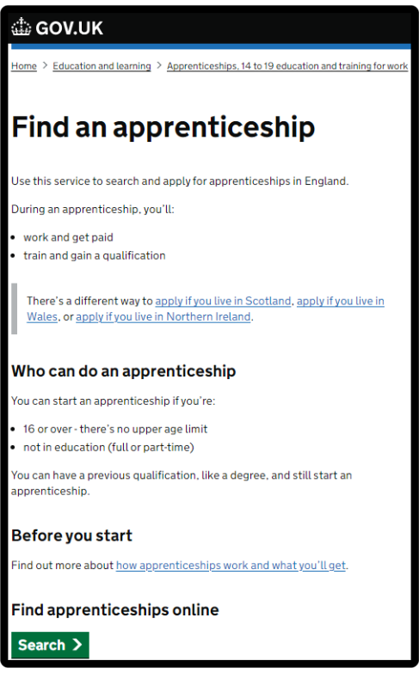




How do you find apprenticeships?
WHAT IS FAA?
Showcasing live apprenticeship jobs
20,000+ vacancies
over the year
Free to use
Secure site
Apply quickly
Notes:
1. It’s really important your child registers on Find an Apprenticeship. They can search the internet for ‘Find an apprenticeship’ and it will come up as the first link. The search page is on gov.uk, an official government site. Once your child registers, they’ll be ready to start applying for apprenticeship vacancies.
2. Have a look at the different jobs that are being advertised. Remember, this is a live jobs site so it may be that they need to try a few different searches or to broaden how far they are looking to find jobs that they are interested in.
It will be important to remind them that vacancies are being added on every day and so it’s important to keep coming back to the site and to use the alerts to be flagged to exciting opportunities. In the meantime, there also lots of other helpful sites they can be searching, including interesting employers.
3. Start applying for jobs that interest them. They need to remember that some of the bigger companies will advertise quite early in the year (e.g. Autumn) for apprentices to start the following September so they should not leave it until the last minute or they might be disappointed to have missed a great opportunity.
Recruitment timeframes may have changed over the last couple of years and so it will be important to stay on top of these.
4. Set up alerts. A great feature of this system is that you can get it to do all the hard work for you. You can manage your alert settings so that you receive text messages and emails when jobs come up that you might be interested in.
5. Employers are always telling us that the applicants that really stand out to them, are those that have made a bit of extra effort. Your child could consider contacting the company and asking them if they have any virtual open days coming up or other opportunities to engage with them. That will look really impressive on their application and can give them an advantage over other applicants

Slide 23
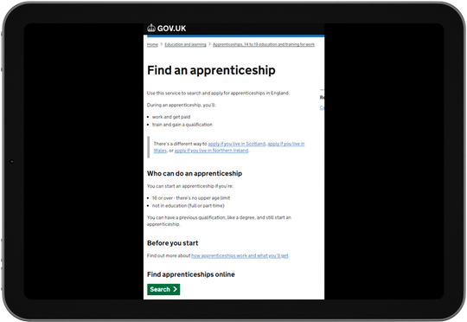



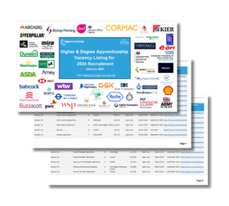

Where else to look
University or College
Training Provider
Find an apprenticeship
Company websites
Careers websites
UCAS
Friends and family
Higher and Degree listing
Social media
Notes:
Whilst Find an apprenticeship is a great place to start looking for apprenticeships, it is not the only place.
If your child has a particular employer in mind, they can visit their website and see if they can sign up for recruitment alerts or if they send out a newsletter.
They can make sure they are following their careers pages on social media using as they will probably use this as a way to promote their vacancies. If they have a LinkedIn profile, it is worth following organisations on there as we have heard from many apprentices more recently that they have found vacancies from employers or training providers on LinkedIn.
We have spoken to lots of apprentices and quite often, they will say that they actually heard about their job through a family member or friend. So you may be able to support them through your own networks to find interesting roles and vacancies.
There are lots of other job search sites out there where you can flick through online profiles for some of the UK’s top apprentice employers.
Definitely spend some time looking into the different types of employers. There will be a real mix from your local council who might have a jobs page for young people, through to bigger recruitment sites too.
The Higher & Degree vacancy listing is also a really useful document that is shared in October and then an updated version is released again in January. This contains a list of hundreds of higher and degree apprenticeship vacancies that are open for application, and gives key information about the employer, the apprenticeship, the salary, location and where to apply. This will be shared on the Amazing Apprenticeships website.

Slide 24






How can I tell if it’s a good apprenticeship?
Wage
Progression
Job position
Training Provider
Varied role
Ethos and values
Notes:
We are often asked by parents if there is any way to find the ‘best apprenticeships’.
The answer is that it will be very personal to each young person and the employer.
But we do have a few hints and tips.
1. What are they being paid? We’re not saying that the highest paying employers are the best or the lowest paying are the worst. A fair wage is an encouraging indicator that the employer is willing to invest in their staff. Remember, employers are able to pay apprentices the National Minimum Wage for Apprentices which is different to the standard National Minimum Wage. This should all be considered alongside the industry standard and what their different pay scales are.
2. What are the likely progression opportunities? If the employer openly discusses progression then it is a good sign they want to keep the apprentice on. Also do you research and check out the employer's website, they may have success stories on there.
3. Is it a permanent or fixed term position? Employers can offer apprentices either a permanent or fixed term apprenticeship. If they are offering fixed term apprenticeships, research if the employer support moving staff into permanent roles on completion. This can be standard in some industries where flexible working is required e.g. broadcast engineer on film projects that are short term.
4. Which training provider are they using? Just like schools, you can check the Ofsted rating of the training provider they are using. You could also look at their website and see if there are any apprenticeship success stories.
5. Is the role varied? Read the job description and see if the employer offers the opportunity to rotate around the business and be involved in a variety of projects.
6. Employer ethos and values You can understand a lot about an employer through their website, social media channels, how they share certain communications and what their values and ethos are. Are they the type of employer your child wants to work for? What else do they do around the apprenticeship for their current apprentices e.g. support networks? How do they support diversity and inclusion? This can help you and your child to get a feel for the employer and their commitment and support of apprentices.

Slide 25
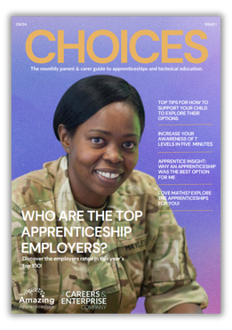





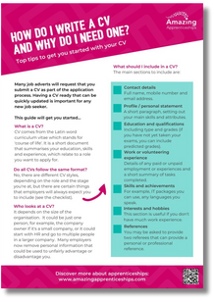
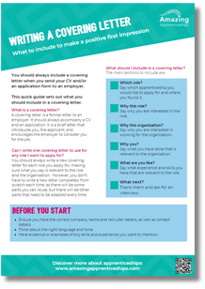

Useful websites & resources
Resources to support you in applying
Choices Magazine
Application guides
Webinars
Podcast
Resources
Employer profiles
www.amazingapprenticeships.com
Notes:
There are an array of resources to support you and your child in researching apprenticeships and how to search and apply for opportunities.
There is a monthly ‘Choices’ magazine produced by Amazing Apprenticeships which is available on their website and on the CEC website. They are really useful and contain lots of different articles and guidance for you, including on apprenticeships as well as other technical pathways like T Levels.
Your school may circulate this to you, but you can also subscribe to receive it by visiting Amazingapprenticeships.com/vacancies.
For other useful information and more resources, you can also go to www.amazingapprenticeships.com.
Amazing Apprenticeships deliver a series of online workshops on behalf of the DfE which are available for parents and carers. These run on a monthly basis and explore apprenticeships and careers options for your child.
There are some other brilliant resources available, including parent/carer guides, podcasts and films.
The web address is showing on the screen now so please make a note of it.

Slide 26



Find out more
www.careersandenterprise.co.uk
www.nationalcareers.service.gov.uk/
www.amazingapprenticeships.com
Notes:
You can also visit the Careers & Enterprise Company website and for more information about apprenticeships.
There is also support available through the National Careers Service, who provide careers information advice and guidance.

Slide 27

Any questions?
Thank you for participating
Notes:
Before we finish, I know we’ve covered a lot today so I wanted to check if there are any final questions at all?
Thank you so much again for joining the session today.

Slide 28
Next steps
Notes:
Presenter note: Please add any information here on follow up sessions or things to promote. For example:
Information about your next session – encouraging attendance / to book on
Upcoming events locally or nationally e.g. National Apprenticeship Week, National Apprenticeship Awards, local careers events or new resources.
This slide will be hidden as a default so please unhide it should you need to include any information.

Slide 29


Your feedback
We hope you found this session helpful.
Please complete the evaluation form using the link or QR code below.
https://tinyurl.com/ASKParentNorth
Notes:
Presenter note: Please use this slide if you are in the North region only. Please ask the parents/carers to complete the survey for this session if appropriate.
This slide will be hidden as a default so please unhide it should you need students to complete the survey.

Slide 30

Your feedback
We hope you found this session helpful.
Please complete the evaluation form using the link or QR code below.
https://tinyurl.com/ASKParentMidlands
Notes:
Presenter note: Please use this slide if you are in the Midlands region only. Please ask the parents/carers to complete the survey for this session if appropriate.
This slide will be hidden as a default so please unhide it should you need students to complete the survey.

Slide 31

Your feedback
We hope you found this session helpful.
Please complete the evaluation form using the link or QR code below.
https://tinyurl.com/ASKParentSouth
Notes:
Presenter note: Please use this slide if you are in the South region only. Please ask the parents/carers to complete the survey for this session if appropriate.
This slide will be hidden as a default so please unhide it should you need students to complete the survey.

Slide 32

Your feedback
We hope you found this session helpful.
Please complete the evaluation form using the link or QR code below.
https://tinyurl.com/ASKParentLondon
Notes:
Presenter note: Please use this slide if you are in the London region only. Please ask the parents/carers to complete the survey for this session if appropriate.
This slide will be hidden as a default so please unhide it should you need students to complete the survey.

