Slide 1
Year 12 Parents’ Information Evening
R.Elmes
Assistant Principal/Head of Sixth Form
7th September 2023

Slide 2
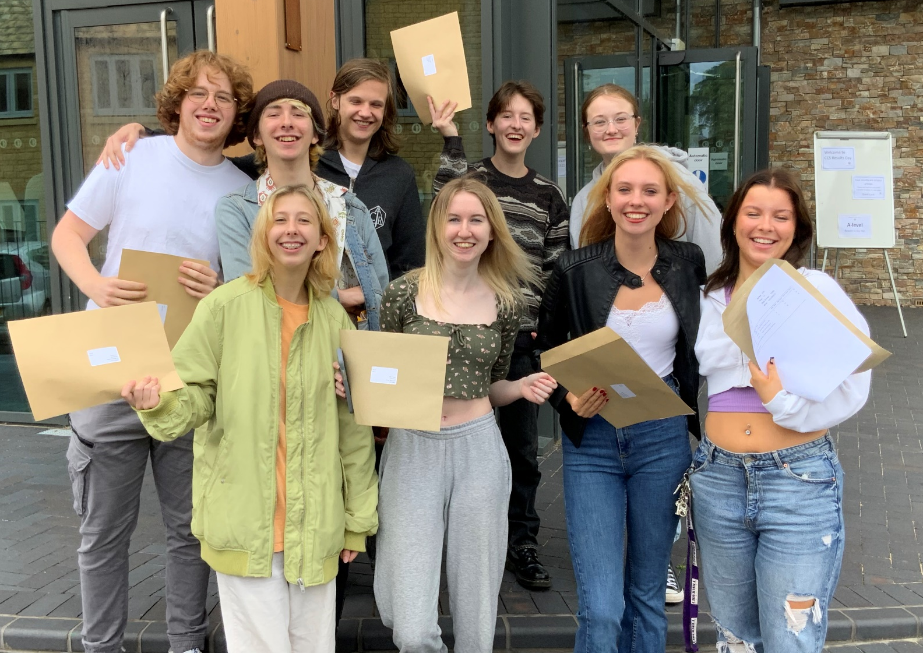
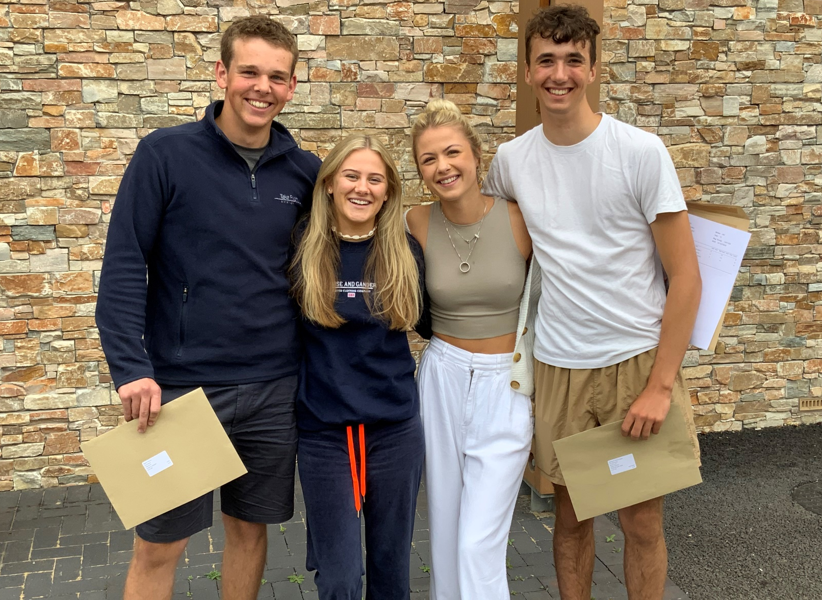
A Level Results Day 2023

Slide 3
What did they do to achieve these results…..
….and…
…. what advice would they give you?

Slide 4
“Others think I am clever. I am not clever, I just work hard”
Year 13 Student who recently achieved 3 A*s at A level

Slide 6
The A-level Mindset (taught in tutor time)
“There is a growing body of research that suggests that successful students approach their studies with a specific set of behaviours, skills and attitudes and that despite not differing cognitively from their peers they can significantly outperform them.
In short, academic success can be as much about character as it is about intelligence”

Slide 7
4 KEY FACTORS
Attitudes and attendance
Organisation
Time management
Balance between academic work, leisure and part-time work

Slide 8
ATTITUDES and ATTENDANCE
You get out what you put in. Hard work, determination, perseverance will pay off
Enthusiasm for your subject and desire to learn without having to be pushed and supervised
Intellectual curiosity or a desire to find out things and to solve problems using own initiative
Positive attitude: put difficulties in perspective
The worst attenders were our biggest under-achievers in 2023

Slide 9
ORGANISATION
Work regularly and steadily
Keep work materials efficiently and effectively. Lesson notes etc. kept in different files for each subject
Make sure you have somewhere suitable where you can work at home
Do not wait to be set work before you do some: reading, organising notes etc.

Slide 10
TIME MANAGEMENT
Minimise stress by keeping a regular routine about when you work and for how long
A minimum of 4-5 hours per subject per week outside lessons
Work regularly with short breaks
Do not ‘over-work’. This causes stress
Do not leave things until the last minute. Plan work well ahead
Plan fun things to look forward to

Slide 11
BALANCE BETWEEN ACADEMIC WORK, LEISURE AND PART-TIME WORK
Very important to get this right
You will enjoy leisure more if you have faced up to your academic commitments
Too much part-time work affects academic performance: More than 9-10 hours a week is probably too much

Slide 12
Advantages
Money!!
Meet new friends
New experiences
New responsibilities (Importance of reliability/punctuality)
Learn new skills (teamwork)
Broader outlook on life outside school
Insight into business or industry (valuable work experience)

Slide 13
Disadvantages
Time taken from school work making it difficult to meet deadlines.
Lose focus on what is your REAL work
Get overtired and lose concentration in school
Not enough leisure time

Slide 14
THERE IS DEFINITELY A COST
Research at the University of Durham has compared A level students who do part-time work with those that do not.
0-9 hours part-time work a week, students on average half a grade down
More than 9 hours, one grade down
When matters: 2 hours after school is sensible. Long stretches in the evening or before school affect academic performance

Slide 15
STRIKE A BALANCE
Organise your life in a balanced way with time for academic work, time to relax and a sensible amount of part-time work to boost your income
Draw back from part-time work, work fewer hours, at academic pressure points especially around the Summer exams
Above all, be clear what your own priorities are in order to achieve your personal goals. You cannot do it all

Slide 16
Our current Year 13 students
“If I knew back then what I know now……………”

Slide 17
11 Things A level students wish they’d known
Use past papers, specimen papers, answer schemes and examiners’ reports
Make lots of notes (and re-read them in between lessons). Start revising early
Be prepared to work at home. Look ahead at what is to come and teach yourself.
Get organised (lever-arch files, dividers, poly pockets)
Treat it like a job (phone to advise of an absence) but try to get in.
6. Respect your deadlines –
do your hwk. as soon as you get it
7. Make sure you understand each topic – aim to teach it to someone else or seek help
8. Don’t panic! Everyone finds it hard at first.
9. Don’t forget to have some fun. Take time off and make new friends
10. Don’t waste your free periods
11. Get some sleep

Slide 18
Distractions that will affect their grades….
…..if they let them!!!

Slide 19
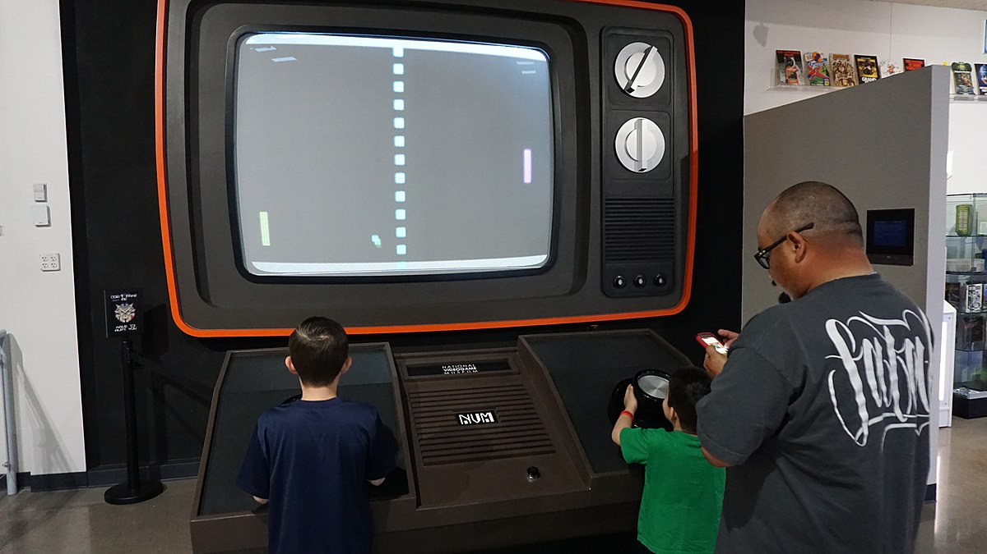
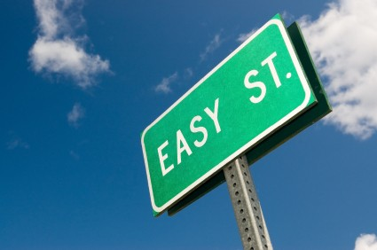

Slide 21
Why year 12 is so important
Good indication of future performance in these linear A levels
Half of the A level course out of the way before year 13
Good year 13 Entrance exam grades enhance UCAS applications and estimated grades
Good Year 13 Entrance exam grades enhance apprenticeship applications
Cannot progress into Year 13 in some cases
Personal pride
Good habits to take into year 13 and HE

Slide 22
Year 12 monitoring, reports and parents’ evenings 2023-24
Ongoing with the SIMS points system and the Sixth Form Pen Award
Reporting schedule - you will receive 3 data reports and a tutor report on:
10th November 2023
12th January 2024
23rd February 2024 (Tutor report)
2nd May 2024
17th July 2024 (Entrance exam results)
Year 13 Entrance exams – 20th June – 2nd July 2024
2 x year 12 Parents’ evening – Thursday 23rd November 2023 / Thursday 9th May 2024
Any other time that is convenient/necessary

Slide 23
Year 12 Work Experience week
Week commencing 8th July 2024

Slide 25
Ipad lease scheme 2023-25

Slide 26
See Mrs Cox

Slide 27
KS5 Parents/open eveUNIGning
Subjects Library: Students can explore HE topics that interest them, and related jobs in the Explore section. They can increase their knowledge of a subject in the Geek Out section.
University & Apprenticeships: Students can explore opportunities available to them after they leave KS5
Personal Statement: Any students applying to UK Universities will write a personal statement.
CV Builder: All students (and parents!) can use the CV builder tool to apply for job opportunities.
Post-18 Intentions: The more information students can give about their intentions for after leaving KS5, the better they can be supported at school or college.

Slide 28
My reminder to students as to why you do what you do as parents………..

